Slide 1
Data Visualization in R
Jenn Schilling
April 12, 2021
Notes:
Your notes here

Slide 2

Hello!
Jenn Schilling
she/her/hers
Senior Data Analyst, University Analytics & Institutional Research, University of Arizona
Adjunct Faculty, System Design Thinking, College for Creative Studies
Notes:
Welcome to Day 1 of the Data Visualization in R webinar. I’m Jenn Schilling, my pronouns are she/her/hers, and it is an honor and a joy to be with you today. I am a senior data analyst at the University of Arizona, and an adjunct faculty member at the College for Creative Studies where I teach graduate classes on data visualization. Thank you for being here, and I hope you will find this webinar beneficial. Before I begin, I would like acknowledge that I am on the ancestral lands of the Tohono O'odham and Pascua Yaqui nations, indigenous peoples who have occupied this land since time immemorial.
Territory acknowledgements are one small part of disrupting and dismantling colonial structures.

Slide 3
Day 1 Agenda
Why is data visualization important?
Best practices in data visualization
Data visualization in R
R setup
How to make a scatterplot in R
How to make a line graph in R
Questions
Notes:
Today we will begin by briefly covering some data visualization concepts and best practices. Then we will dive into data visualization in R, getting set up, and making two different types of plots.

Slide 4
Learning Outcomes
Explain how the grammar of graphics works in R
Create three different plots in R
Add titles and labels to a plot in R
Change the formatting of a plot in R
Notes:
The learning outcomes of this webinar are that participants will be able to explain how the grammar of graphics works in R, create three different plots in R, add titles and labels to a plot in R, and change the formatting of a plot in R.

Slide 5
Why visualize data?
Gain understanding
Show patterns
Engage viewer
Convince viewer
Tell a story
Notes:
There are many excellent resources on data visualization, including some webinars by AIR. However, I wanted to begin by covering some basic principles of data visualization. First of all, why do we visualize data? Some reasons may be to gain understanding of data, to show patterns, to engage or convince the viewer of something, or to tell a story. But, we need to be careful with patterns because we can easily jump to conclusions and see causality when it is not there. And we need to be careful with storytelling too because we must ensure that we are accurately and truthfully representing the data (plus we have a tendency to attach stories to patterns that we see that may not be accurate). So, to ensure that we are representing data truthfully and accurately, it’s important to explore the data first and then craft the message rather than the other way around.

Slide 6
Datasets of (x, y) coordinate pairs
dataset | mean_x | mean_y | sd_x | sd_y | corr
1 | 54.27 | 47.83 | 16.77 | 26.94 | -0.06
2 | 54.27 | 47.83 | 16.77 | 26.94 | -0.07
3 | 54.27 | 47.84 | 16.76 | 26.93 | -0.07
4 | 54.26 | 47.83 | 16.77 | 26.94 | -0.06
5 | 54.26 | 47.84 | 16.77 | 26.93 | -0.06
6 | 54.26 | 47.83 | 16.77 | 26.94 | -0.06
7 | 54.27 | 47.84 | 16.77 | 26.94 | -0.07
8 | 54.27 | 47.84 | 16.77 | 26.94 | -0.07
9 | 54.27 | 47.83 | 16.77 | 26.94 | -0.07
10 | 54.27 | 47.84 | 16.77 | 26.93 | -0.06
11 | 54.27 | 47.84 | 16.77 | 26.94 | -0.07
12 | 54.27 | 47.83 | 16.77 | 26.94 | -0.07
13 | 54.26 | 47.84 | 16.77 | 26.93 | -0.07
Notes:
Here’s some more motivation for visualizing data. I have 13 datasets of (x, y) coordinate pairs. In this table, I have summarized the data with means, standard deviations, and correlations. From this table, it appears that all 13 datasets are quite similar.

Slide 7
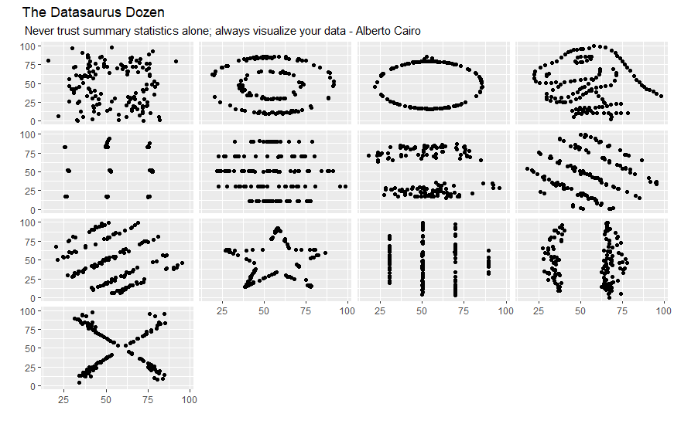
Datasets Visualized
Notes:
However, when we visualize those 13 datasets, we can see that they are all widely different from one another. One even makes a dinosaur! These datasets were created by Alberto Cairo to provide motivation to visualize data.

Slide 8
Best Practices in Data Visualization
“A good visualization is:
reliable information,
visually encoded so relevant patterns become noticeable,
organized in a way that enables at least some exploration, when it’s appropriate,
and presented in an attractive manner, but always remembering that honesty, clarity, and depth come first.”
(Cairo, 2016, p. 12)
Notes:
So, what makes an effective data visualization?
This is not a simple question with a straightforward answer, but broadly speaking, it is important to be honest and truthful and accurately represent the data while keeping in mind the audience, the goal to inform the audience, and the principles around how humans perceive visual elements. This quote comes from Cairo’s book The Truthful Art.
Cairo, A. (2016). The truthful art: Data, charts, and maps for communication. New Riders

Slide 9
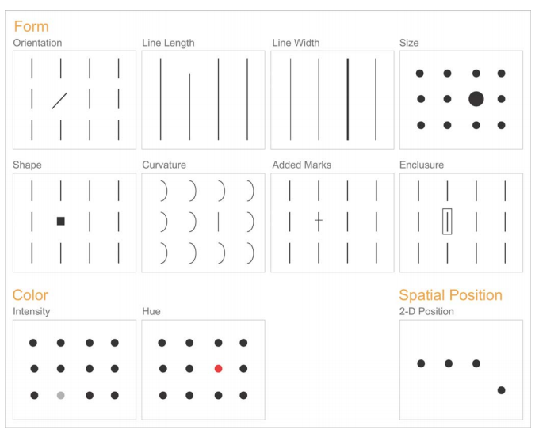
Best Practices in Data Visualization
(Few, 2004, p. 5)
Notes:
One best practice in data visualization is to keep in mind the preattentive attributes. These attributes are represented in the visual above, which is from Stephen Few’s paper on Visual Perception. Preattentive attributes are interpreted without conscious awareness. The preattentive attributes are ways to encode data that will easily allow the viewer to pick things out or compare them.
Few, S. (2004). Tapping the Power of Visual Perception. Retrieved March 7, 2021, from https://www.perceptualedge.com/articles/ie/visual_perception.pdf

Slide 10
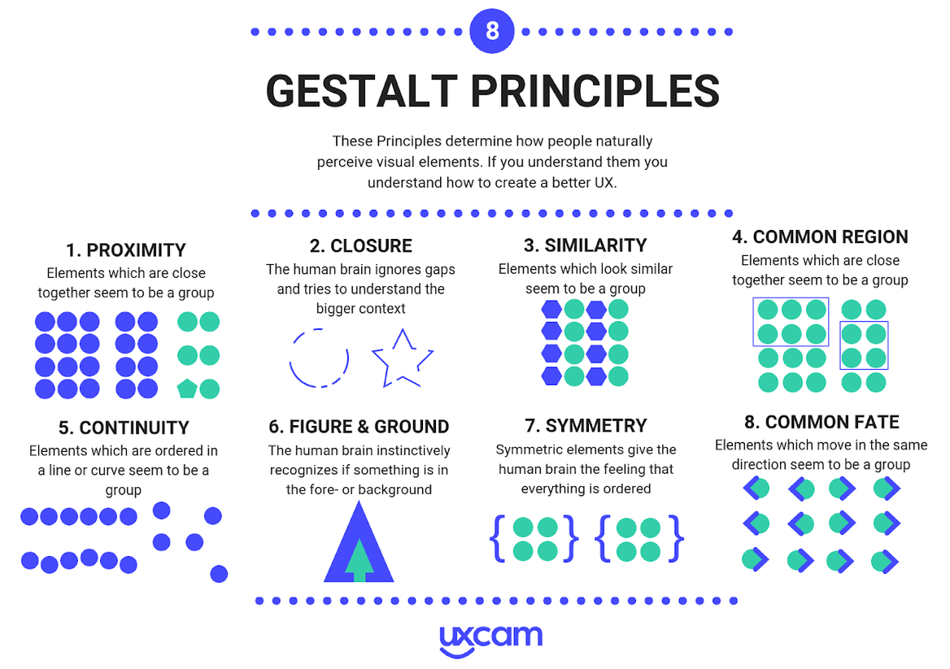
Best Practices in Data Visualization
(Bufe, 2019)
Notes:
Gestalt Principles are also important and useful for helping viewers interpret data visualizations. These principles are used in design, but can also be used in data visualization, particularly the principles of proximity, similarity, and continuity.
Bufe, A. (2019, November 26). Gestalt principles: The complete overview. Retrieved March 08, 2021, from https://uxcam.com/blog/gestalt-principles/

Slide 11
Best Practices of Data Visualization
The Five Qualities of Great Visualizations:
Truthful
Functional
Beautiful
Insightful
Enlightening
(Cairo, 2016, p. 45)
Notes:
Finally, Cairo lists five qualities of great data visualizations in his book The Truthful Art; data visualizations should be truthful, functional, beautiful, insightful, and enlightening. These are qualities we can keep in mind when designing data visualizations, and these are things that I think ggplot2 and R make easy to do once you get the hang of the process. The graphs we will look at in this webinar are not particularly beautiful or enlightening as they have been made with the intention more of developing ggplot2 knowledge, but hopefully you will find them truthful, functional, and insightful to how the ggplot2 process works.
Cairo, A. (2016). The truthful art: Data, charts, and maps for communication. New Riders

Slide 12

Data Visualization in R
Library: ggplot2
Robust
Iterative
Flexible
Functional
Reproducible
Notes:
To build data visualizations in R, we will use the ggplot2 package, which is part of the tidyverse collection of packages. I really like ggplot2 and creating data visualizations in R because I find it to be a robust process that is easy to iterate on. It is flexible and it is certainly very functional. Using ggplot2 also allows graphs and plots to be reproduced since they are entirely created by code.

Slide 13
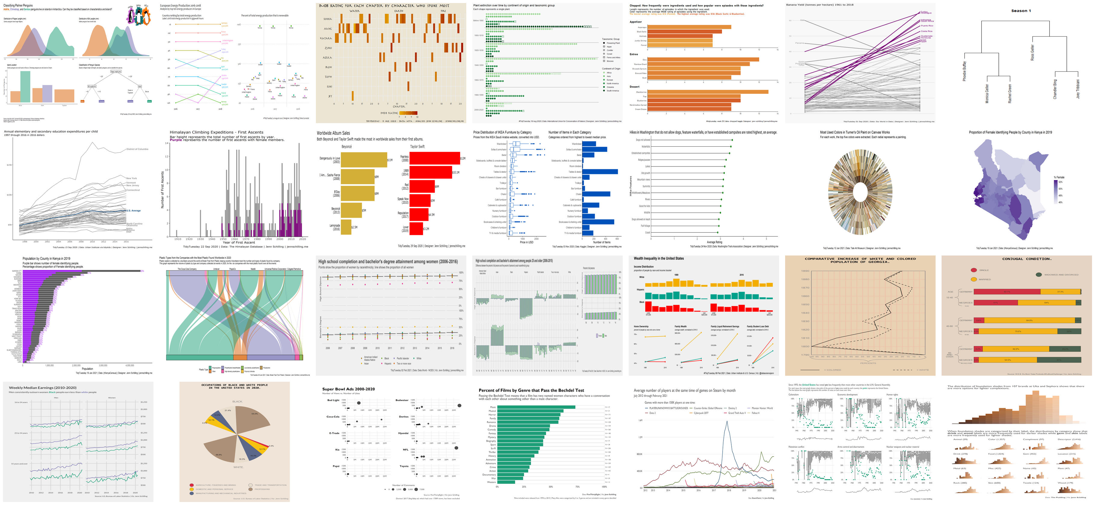
What’s Possible with ggplot2?

Slide 14
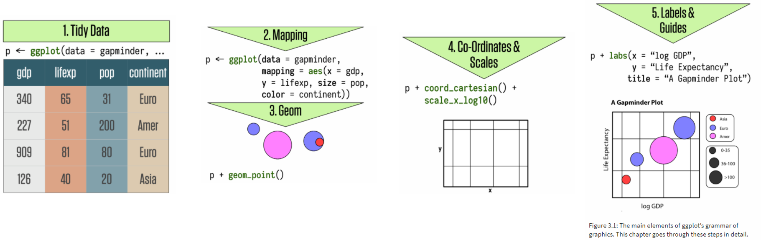
The Grammar of Graphics
The basis of ggplot2
Build plots in layers:
Data to be visualized
Aesthetic mappings
Geometric objects
Statistical transformations
Coordinates
Scales
Facets
(Wickham, 2010, p. 8; Healy, 2019, p. 56)
Notes:
ggplot2 is built as a grammar of graphics. The gg stands for grammar of graphics and forms the basis of the methodology in ggplot2. The idea is to build plots up layer by layer and specify the different pieces of plot as you go. Starting with the data to be visualized, the user defines aesthetic mappings that define how the data will be mapped to plot elements, such as x and y. Then geometric objects are added on to define how those plot elements will be displayed, for example as points or lines. It is possible to make statistical transformations of the data when it is plotted, although we won’t be covering that in this webinar. The coordinate system can be defined in ggplot2 as well as the scales that are used on the axes and colors. Faceting allows small multiple plots to be developed that show plots by groups. Finally, labels and legends can be added and customized.
Wickham, H. (2010). A layered grammar of graphics. Journal of Computational and Graphical Statistics, 19(1), 3-28. Retrieved March 7, 2021, from http://vita.had.co.nz/papers/layered-grammar.pdf
Healy, K. (2019). Data visualization: A practical introduction. Princeton, NJ: Princeton university press.

Slide 15
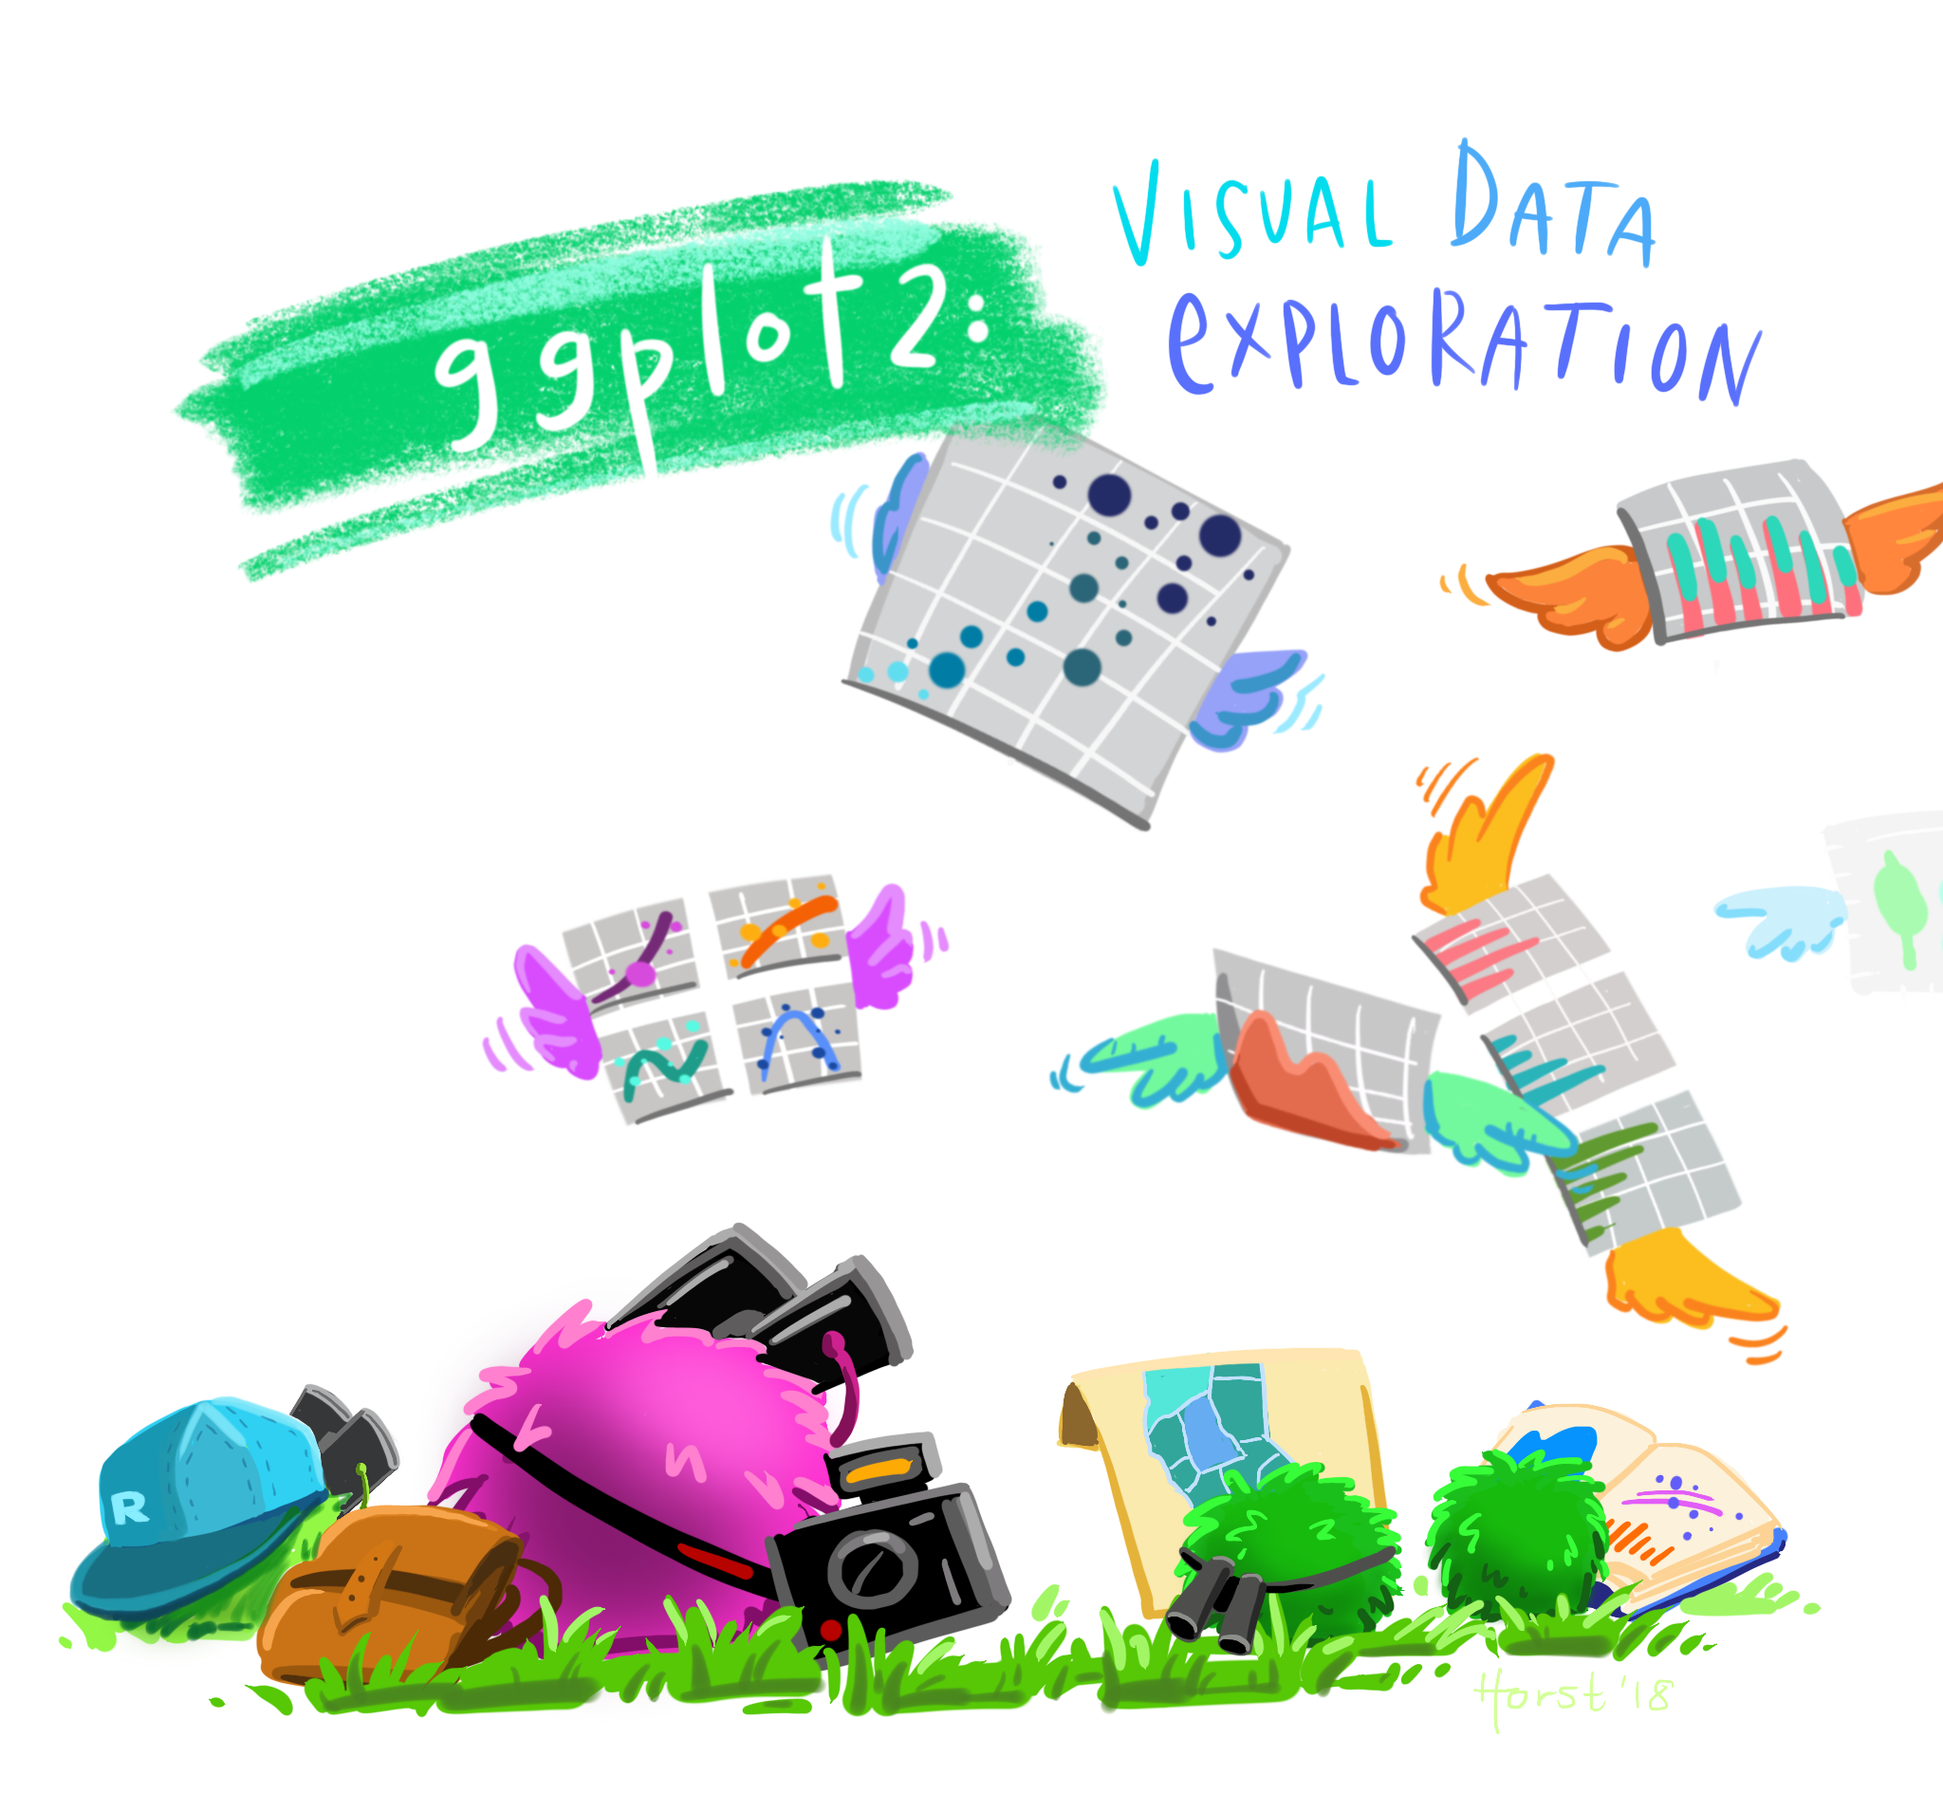
Artwork by @allison_horst
Notes:
ggplot2 can be used to complete visual data exploration. Once you get the hang of it, it’s very easy to quickly generate rough plots to explore your data.

Slide 16
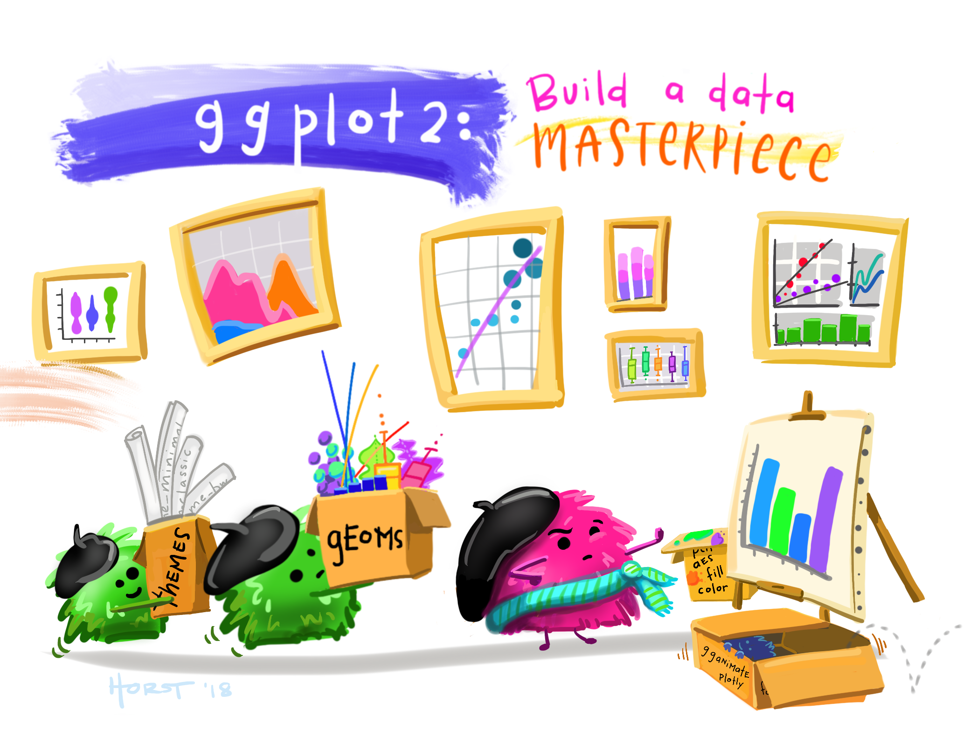
Artwork by @allison_horst
Notes:
ggplot2 can also be used to create well designed and engage data visualizations and infographics. It’s flexibility allows for almost endless customization.

Slide 17
R Setup
General Setup
R Markdown
tidyverse package
Tidy data
Webinar Materials
code
data-viz-in-r-code.Rmd
data
ipeds_2017
ipeds_2018
ipeds_2019
ipeds_dict
plots
.here
README.txt
Notes:
To get set up in R, all you will need is the tidyverse package installed and a set of tidy data.
R Markdown is a very useful tool/file format that can be used to create documentation along with your code. This is ideal for reproducibility.
The webinar materials provided include an R Markdown file with all the code to process the data and create the plots used in this webinar, the data files used, which I will discuss in a little more detail soon, and a folder for plots. The .here file is needed so that the R Markdown code knows where to find the data files and save the plot. The README file contains more information about each individual file and the structure of the folder.

Slide 18

Illustrations from the Openscapes blog Tidy Data for reproducibility, efficiency, and collaboration by Julia Lowndes and Allison Horst
Notes:
Tidy data is a structure of data in which each variable is a column, each observation is a row, and each cell is a single measurement.

Slide 19
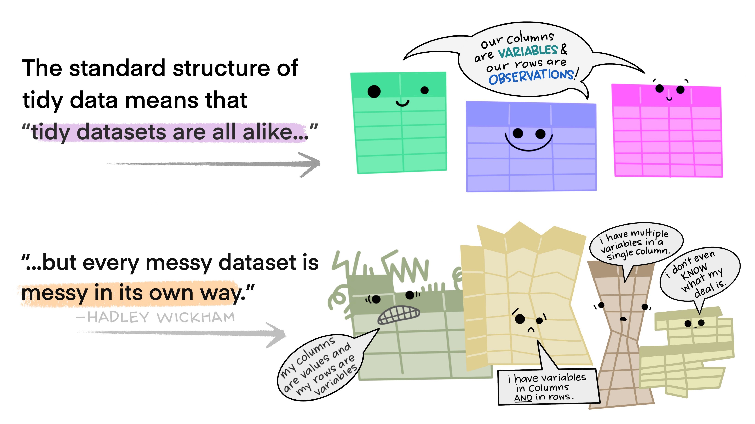
Illustrations from the Openscapes blog Tidy Data for reproducibility, efficiency, and collaboration by Julia Lowndes and Allison Horst
Notes:
Tidy data is useful because multiple datasets in a tidy format are alike.

Slide 20
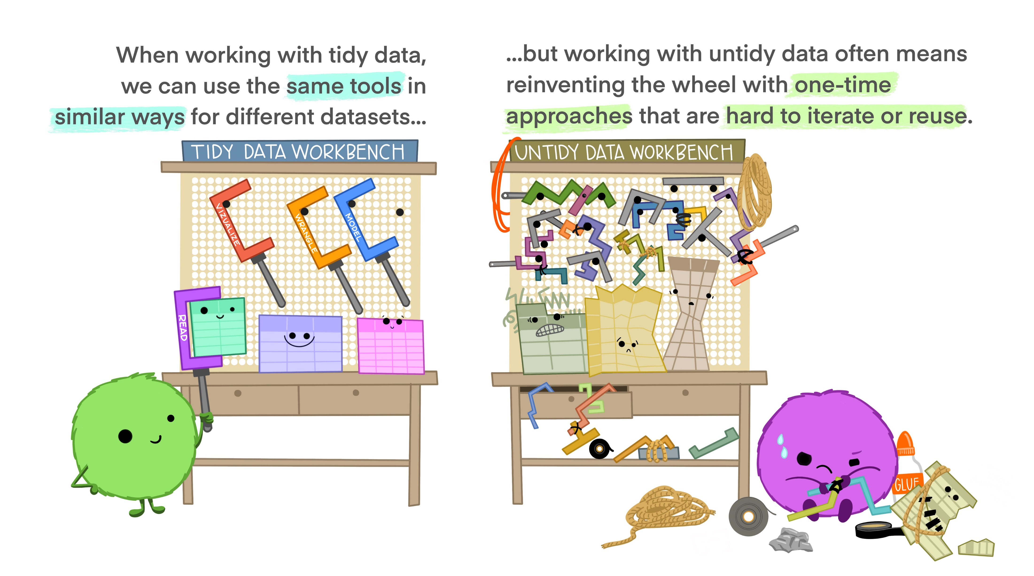
Illustrations from the Openscapes blog Tidy Data for reproducibility, efficiency, and collaboration by Julia Lowndes and Allison Horst
Notes:
This means that the same tools can be used in similar ways on tidy data sets, which is very useful. ggplot2 is easiest to use on tidy data.

Slide 21
Data
IPEDS
Directory
Completions
Enrollment
Admissions
2017-2019
16 Institutions
Reformatted to be tidy
Notes:
The data we will be using for this webinar is from IPEDS. I used data from the directory to get information about the institutions. Then I pulled completions, enrollment, and admissions data for the past 3 survey years. I limited it down to 16 institutions. Since I work at the University of Arizona, I used my institution and our Arizona Board of Regents defined peer group. There was quite a bit of data processing necessary to recode some of the values to their descriptive values and reformat the data into a tidy format.

Slide 22
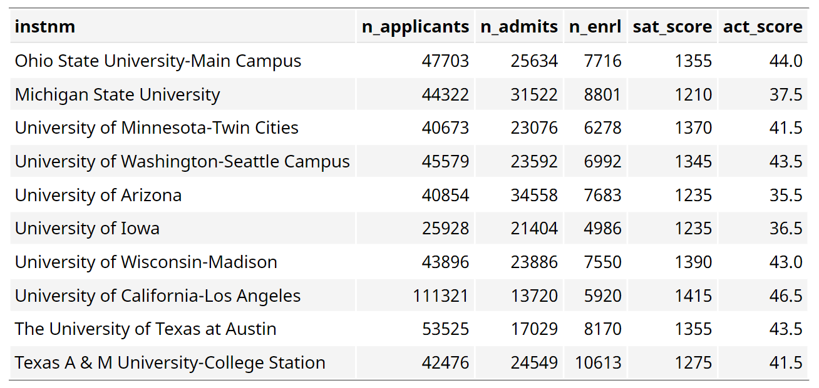
Plotting in R – Tidy Data (inst_adm_plot)
Notes:
For 2019, the SAT and ACT scores by institution, along with the number of applicants, number of admits, and number of students who enrolled.

Slide 23
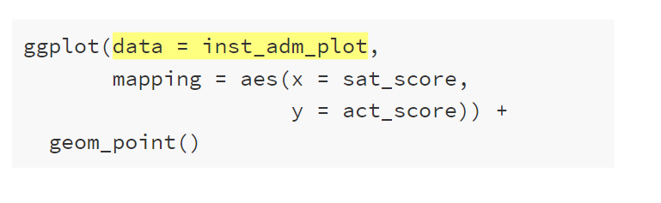
Plotting in R – Data
Notes:
Within the ggplot() function, we set the data argument

Slide 24
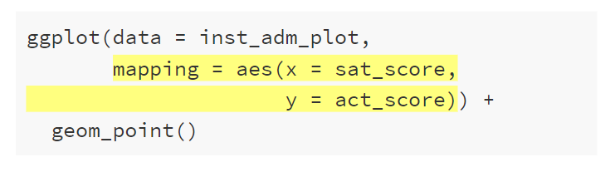
Plotting in R – Aesthetic Mappings
Notes:
Within the ggplot() function, we set the mapping argument using the aes() function

Slide 25
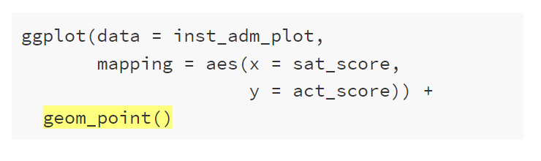
Plotting in R – Geometric Objects
Notes:
We add on geom_point()

Slide 26
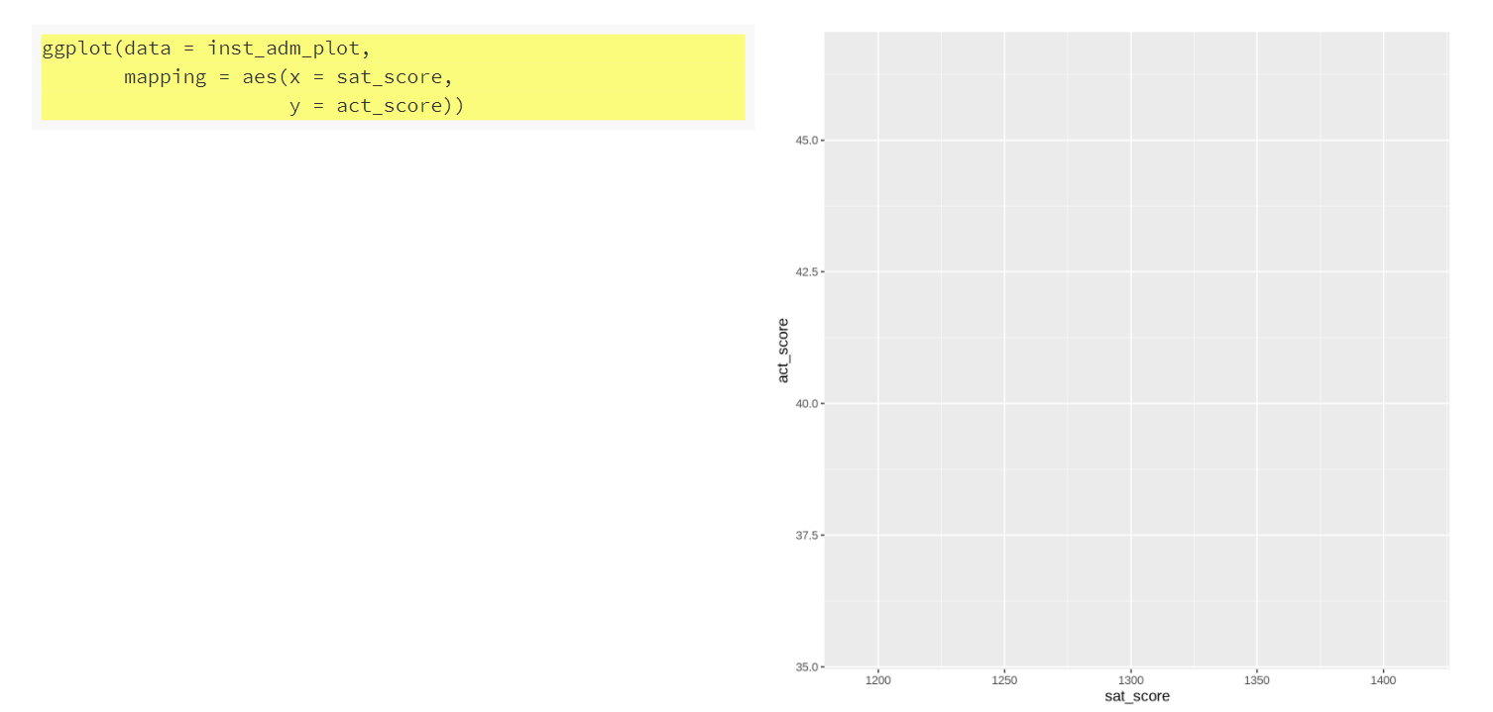
Plotting in R – Make a Scatterplot
Notes:
The ggplot() function alone sets up the axes and plot area but we have no geoms

Slide 27
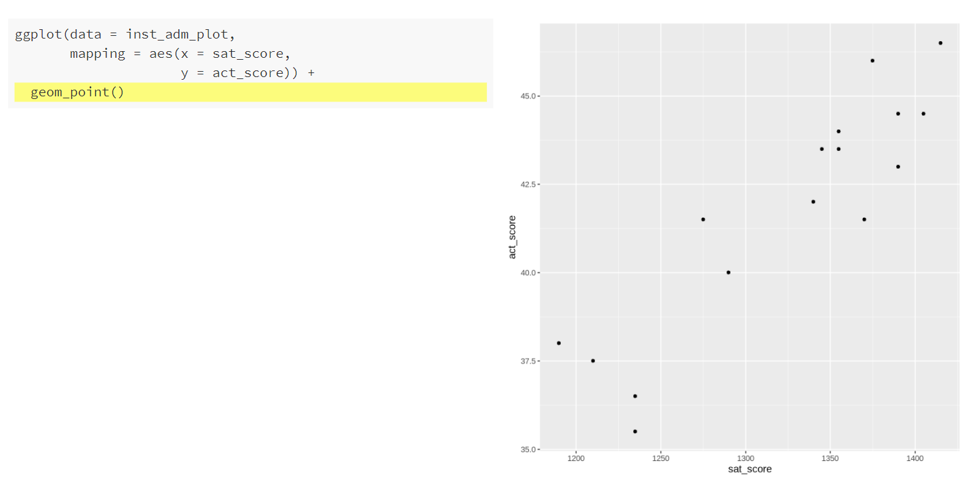
Plotting in R – Make a Scatterplot
Notes:
Now that geom_point() has been added, the points show and we have a scatterplot. Any scatterplot can be made in similar fashion by setting the x and y mappings to numeric variables

Slide 28
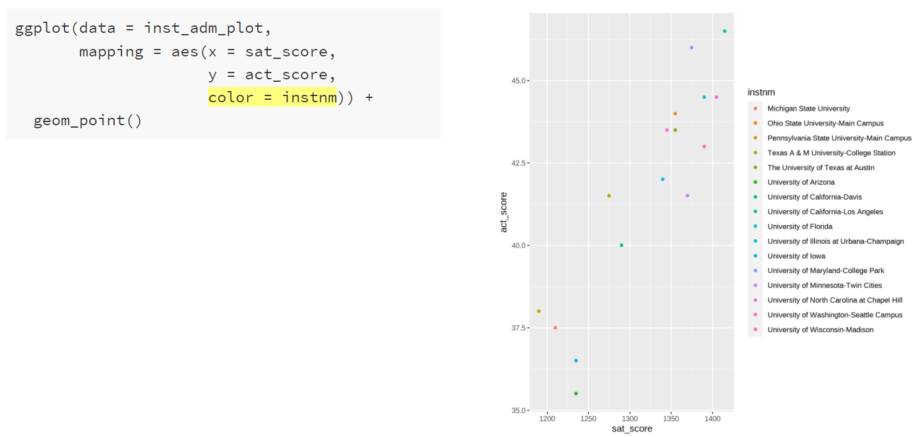
Plotting in R – Make a Scatterplot
Notes:
Color can be added to the scatterplot points by populating the “color” argument of the aesthetics mappings. Now, each point is given a color based on the institution name.

Slide 29
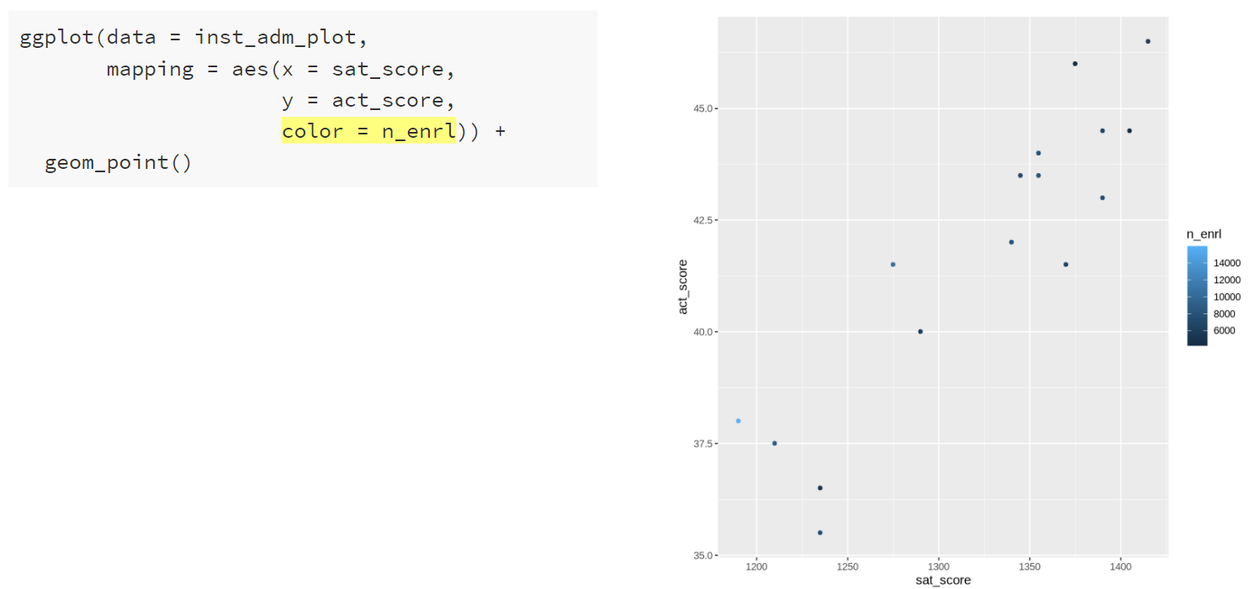
Plotting in R – Make a Scatterplot
Notes:
We can also assign color using a numeric variable, in this case R uses a gradient color scale to assign color by the number of students enrolled.

Slide 30
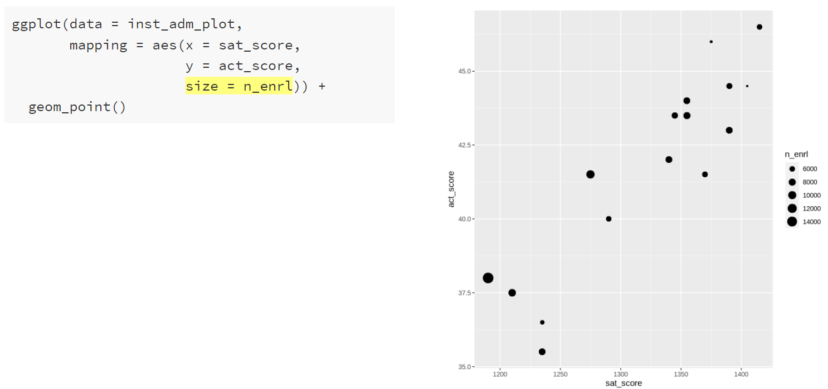
Plotting in R – Make a Scatterplot
Notes:
Another piece of the aesthetics mapping function is the size argument. We can assign this to the number of students enrolled, and it sizes the points by the number of students enrolled.

Slide 31
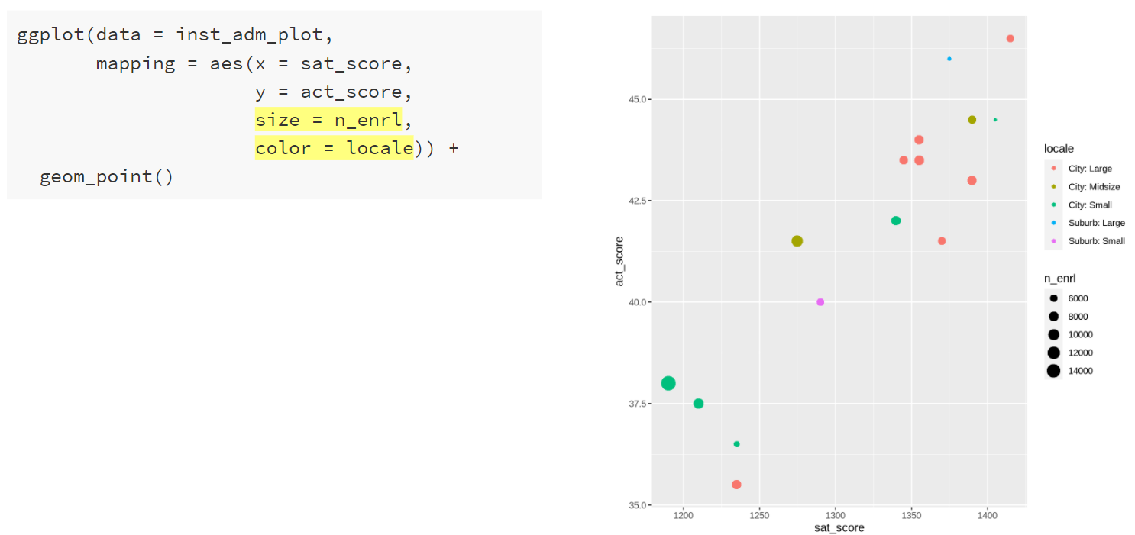
Plotting in R – Make a Scatterplot
Notes:
Size and color can be used together.

Slide 32
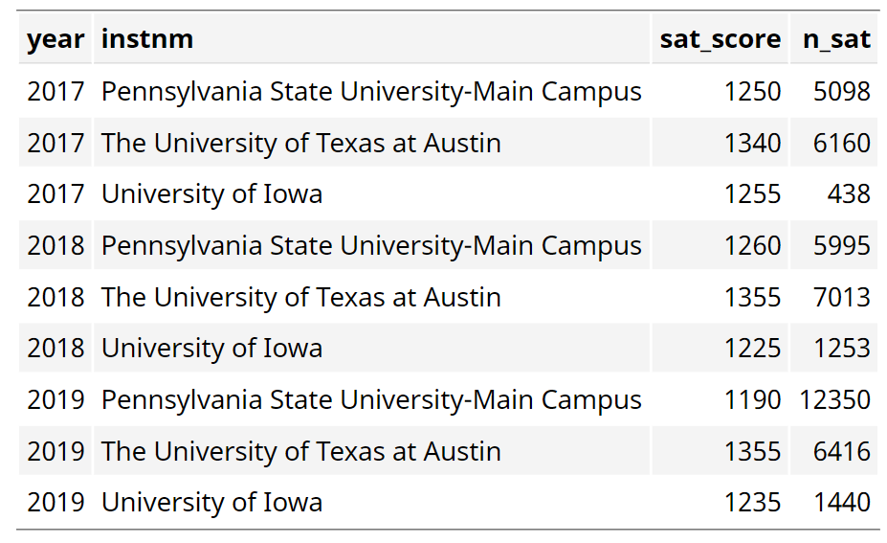
Plotting in R –Tidy Data (inst_adm_plot)
Notes:
New data set in tidy format, by year and institution, what were the SAT scores and how many applicants submitted SAT scores.

Slide 33
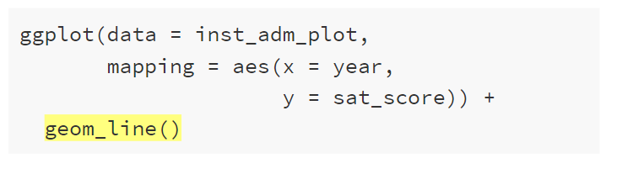
Plotting in R – Geometric Objects
Notes:
The mapping has changed slightly, now x is year and y is sat_score. Also, we’ve replaced geom_point() with geom_line().

Slide 34
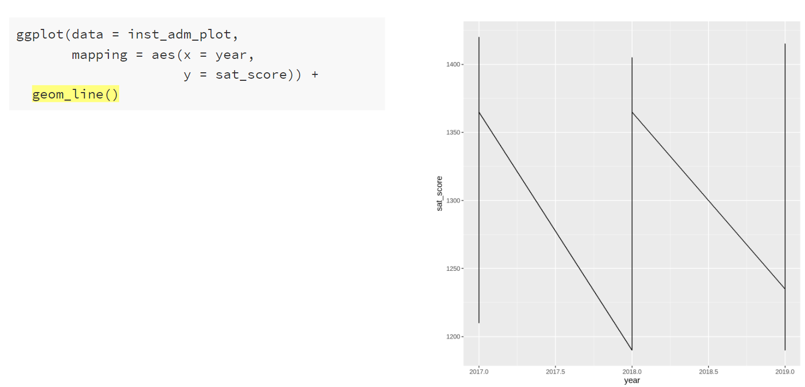
Plotting in R – Geometric Objects
Notes:
Something is not right. There’s only one line and it looks kind of odd.

Slide 35
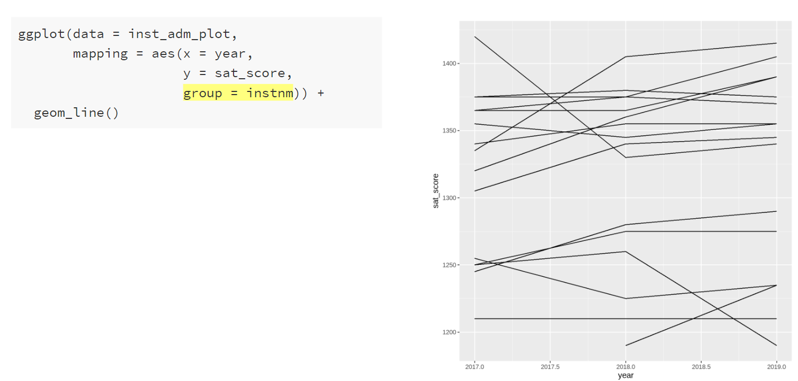
Plotting in R – Aesthetic Mappings
Notes:
We need to add the institution name (or some other unique row identifier) to the mapping so that geom_line() will create one line per row. We do this using the group argument in the aes() function. This tells the geom_line() function how to group the data together when plotting the lines.

Slide 36
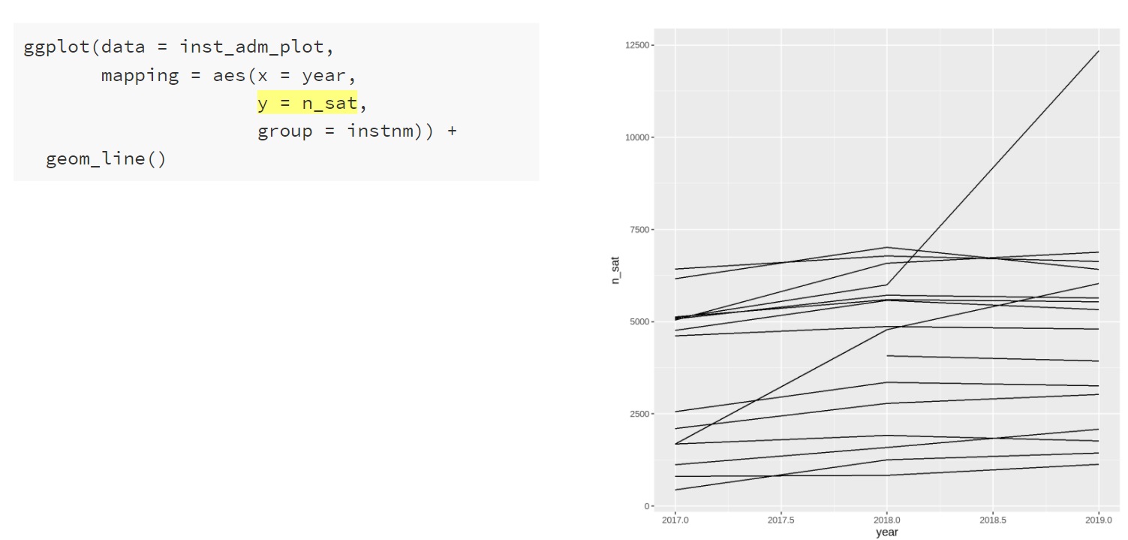
Plotting in R – Line Graph
Notes:
This is another line graph, this time with the number of students submitting an SAT score on the y-axis. There’s an outlier in 2019, I wonder which institution that is.

Slide 37
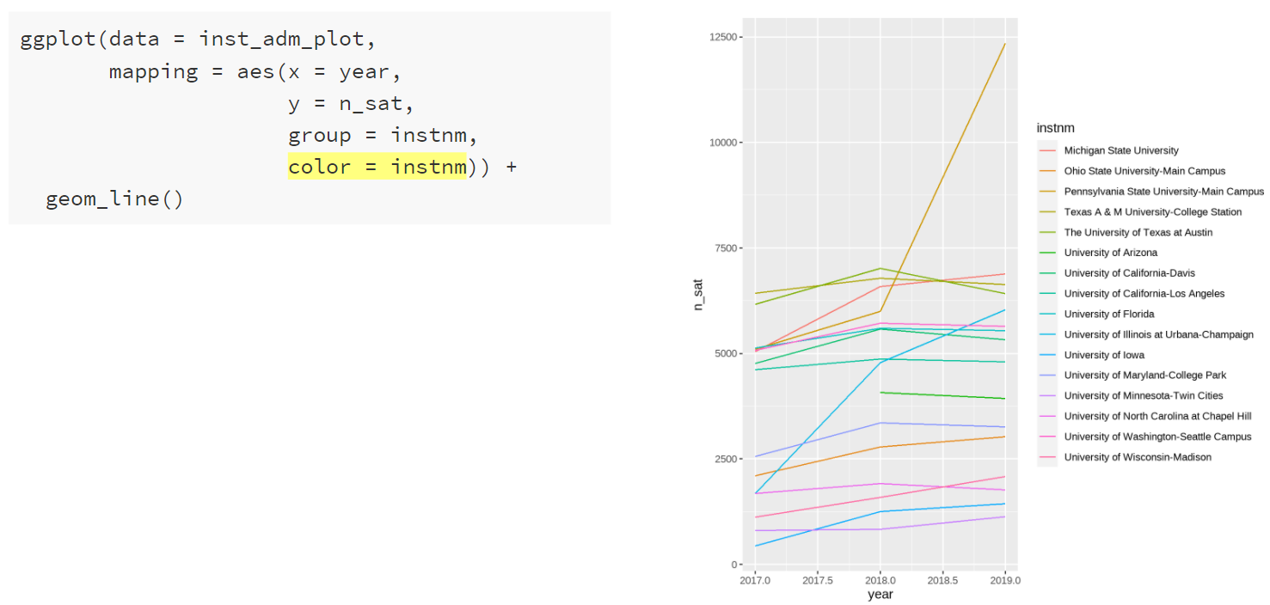
Plotting in R – Line Graph
Notes:
One way we could identify institutions in this plot is using the color argument. Similarly to the scatterplot, we can set the color argument to the institution name, and ggplot will map the name onto the color. Each line is given a different colur and we can see the list of institutions in the legend.

Slide 38
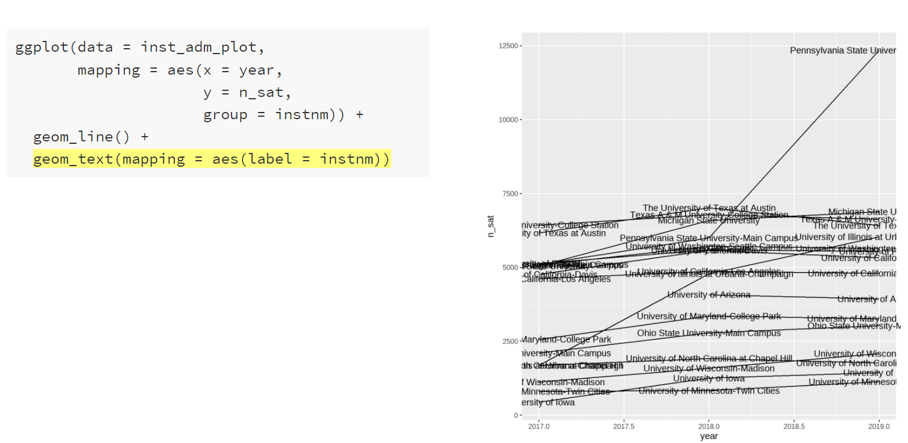
Plotting in R – Line Graph
Notes:
Another way to identify each line is using labels. We can add labels using geom_text() and adding the label argument to the aes() function. But now we get labels for every year, which is not really what we want.

Slide 39
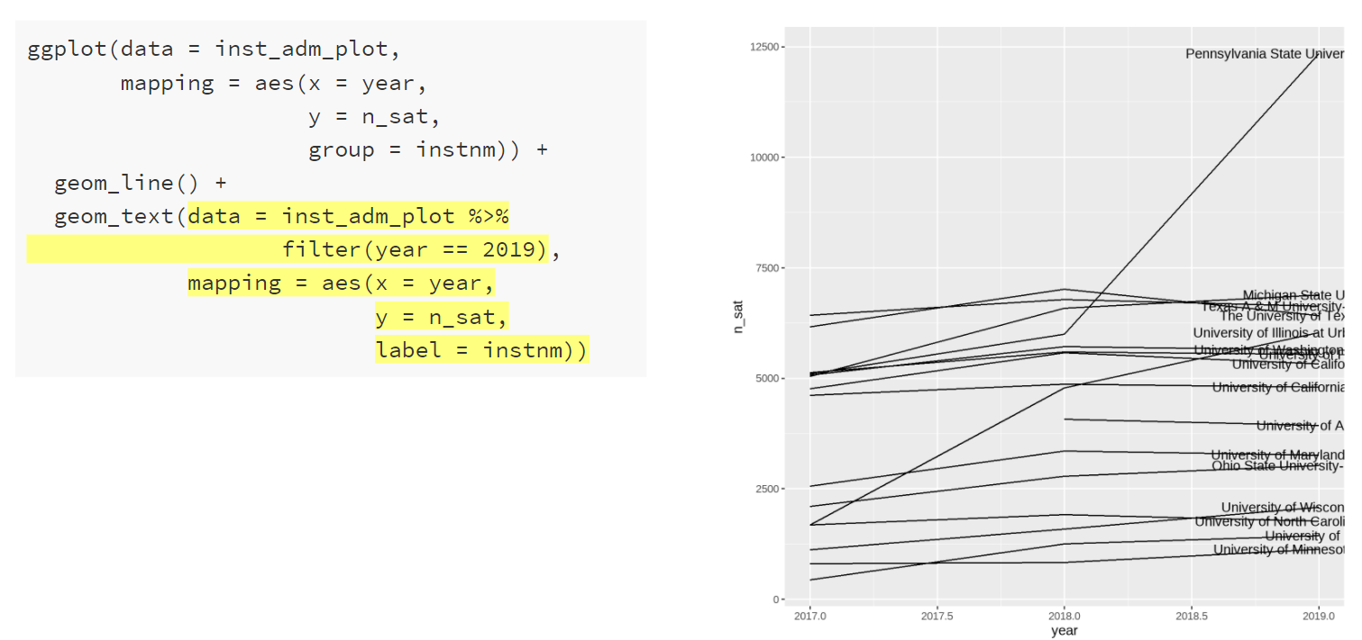
Plotting in R – Line Graph
Notes:
Let’s change the data within the geom_text() function – you can actually do this on any geom function. We will also add to the mapping argument – now we need to set the x and y aesthetic mappings for the text. Before, these mappings were pulled from the ggplot() function arguments. But the labels are quite hard to read.

Slide 40
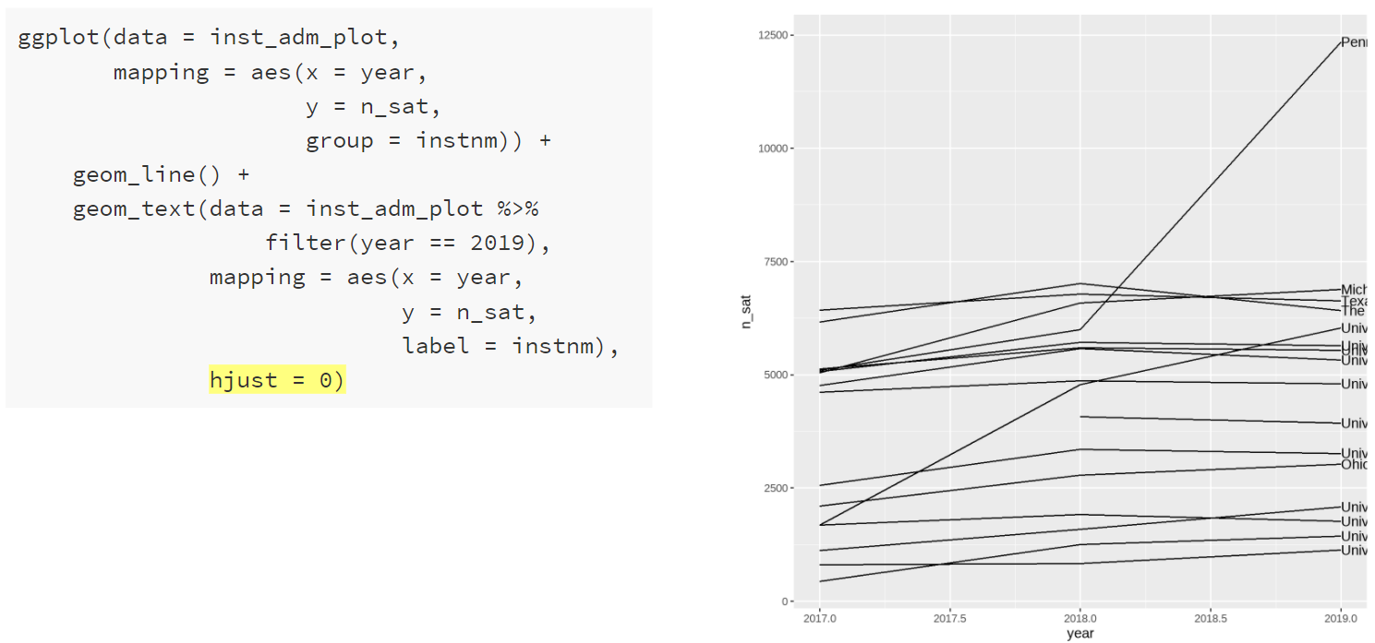
Plotting in R – Line Graph
Notes:
To move the labels to the end of the line, we use hjust = 0 to left-justify them. Within the geom_text() function, we can set the horizontal and vertical justification of the text labels.

Slide 41
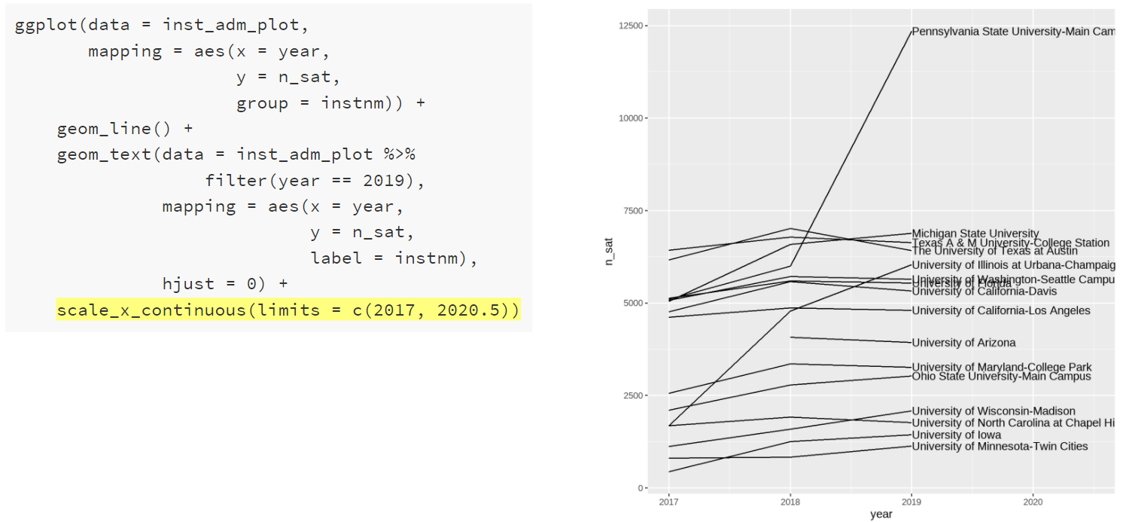
Plotting in R – Line Graph (Adjust Scales)
Notes:
We can make the labels easier to read by expanding the x-axis. Axis ranges or limits can be changed using functions like scale_x_continuous(). We use this function because the x-axis represents a continuous variable. There are similar scale functions for the y-axis, color, and size. There are also scale functions for discrete or binned variables. Here we will manually set to x-axis limits to expand the range of the axis. Now the labels are more visible. They are still not completely visible, and we could adjust the upper limit further to view the whole label. Or we could take a different approach to add these labels.

Slide 42
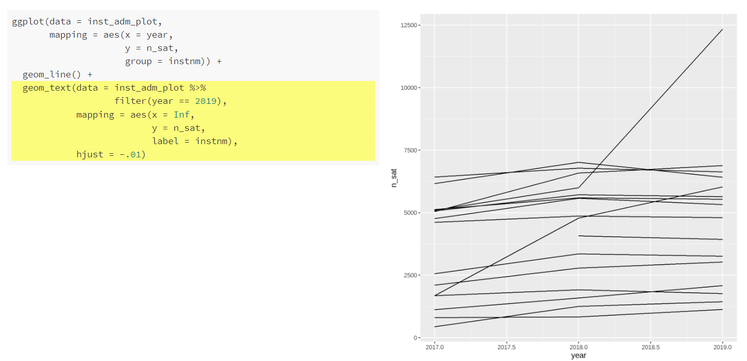
Plotting in R – Line Graph
Notes:
To make the labels easier to read, we can make one change to the mapping in the geom_text() function. We set the x argument equal to infinity to push the labels off the plot. We also use the horizontal justification argument hjust to left justify the labels and then move them slightly in. hjust = 0 is right justified, hjust = 0.5 is centered, and hjust = 1 is left justified. You will notice that we can’t actually see any of the labels right now.

Slide 43
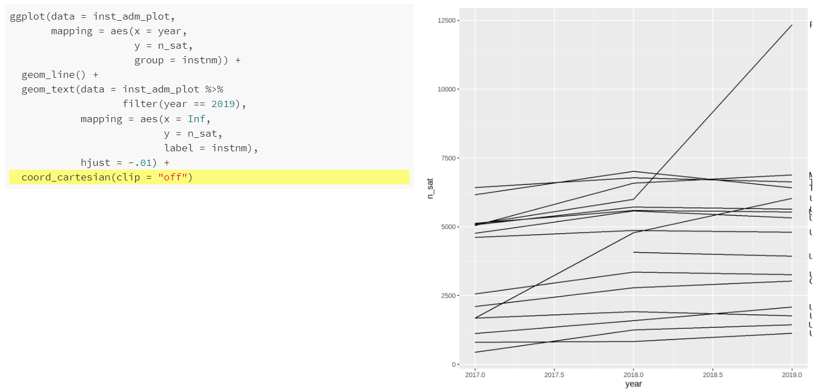
Plotting in R – Line Graph
Notes:
We’ve added a new function coord_cartesian(). This function is used to zoom in or out the plot without changing the underlying data or axis limits. If we set clip to “off” (the default is on), then the drawing of ggplot elements can extend past the plot panel. The plot panel is the area in which the geometric elements are drawn in a plot (the grey area). We still cannot really see our labels, but by setting the clip to “off” it allows the text elements to be drawn outside of the plot panel, which is what we want.

Slide 44
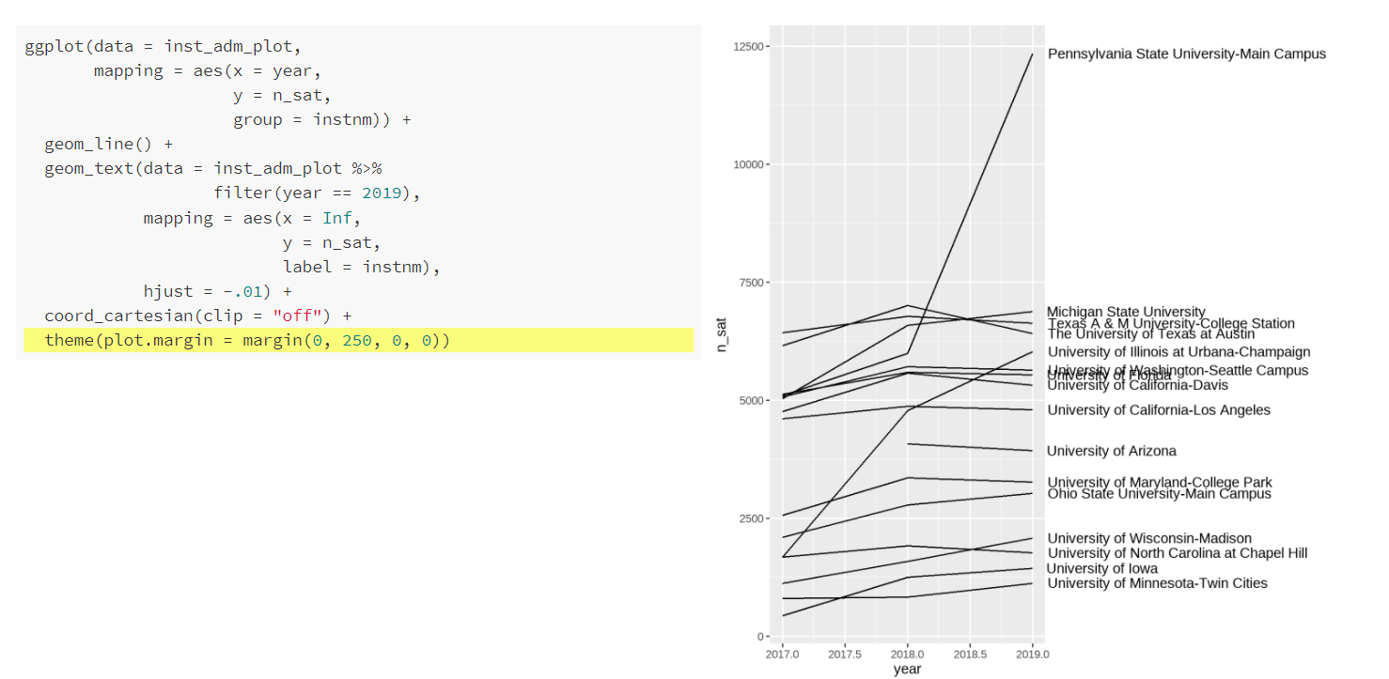
Plotting in R – Line Graph
Notes:
Finally, we use another new function theme(). The theme() function allows us to manually set all of the plot formatting. We can use it to change fonts, manipulate spacing, and change colors. Generally, it controls the way the plot looks. In this instance, we are going to use the plot.margin argument to extend the right-hand margin so that we can view the entire label. We will get more into the theme function tomorrow. It is very useful for customizing the look of your plots.

Slide 45
What did we learn today?
Basic principles of data visualization
Motivation for using ggplot2
How to get started with ggplot2
How to make a scatterplot in R
How to make a line graph in R

Slide 46
Questions

Slide 47
Data Visualization in R
Jenn Schilling
April 13, 2021
Notes:
Your notes here

Slide 48
Day 2 Agenda
Recap of previous session
How to make a bar graph in R
Adding and changing titles and labels in R
Formatting options for plots in R
How to save a plot in R
Where to go from here
Questions
Notes:
Welcome back to Day 2 of the Data Visualization in R webinar. It is an honor and a joy to be with you today. Here’s today’s agenda.

Slide 49
Learning Outcomes
Explain how the grammar of graphics works in R
Create three different plots in R
Add titles and labels to a plot in R
Change the formatting of a plot in R
Notes:
These are the learning outcomes for this webinar series.

Slide 50
Quick Recap
Grammar of graphics
R setup
Making a plot
Notes:
To recap from yesterday. We covered some principles of data visualization, including the pre-attentive attributes, gestalt principles, and Alberto Cairo’s five qualities of effective data visualization. We then briefly covered tidy data and some motivation for using R and ggplot2. We learned how to make a basic scatterplot in R and then we went over how to make a line graph and add labels to it in R.

Slide 51
The Grammar of Graphics
The basis of ggplot2
Build plots in layers:
Data to be visualized
Aesthetic mappings
Geometric objects
Statistical transformations
Coordinates
Scales
Facets
(Wickham, 2010, p. 8; Healy, 2019, p. 56)
Notes:
This is a reminder of how ggplot2 works and how plots are built in layers through ggplot2. Yesterday we looked at some aesthetic mappings and geometric objects and briefly touched on coordinates. Today we’re going to cover both aesthetic mappings and geometric objects in more detail as well as go into scales and facets.
Wickham, H. (2010). A layered grammar of graphics. Journal of Computational and Graphical Statistics, 19(1), 3-28. Retrieved March 7, 2021, from http://vita.had.co.nz/papers/layered-grammar.pdf
Healy, K. (2019). Data visualization: A practical introduction. Princeton, NJ: Princeton university press.

Slide 52
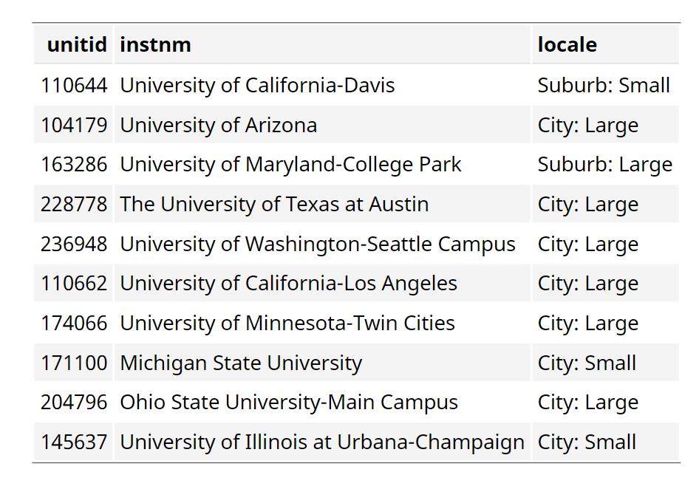
Plotting in R – Tidy Data (inst_list)
Notes:
This dataset is the list of institutions with their directory information, including the urban area description. We can make a bar graph that will show the number of institutions in each urban area.

Slide 53
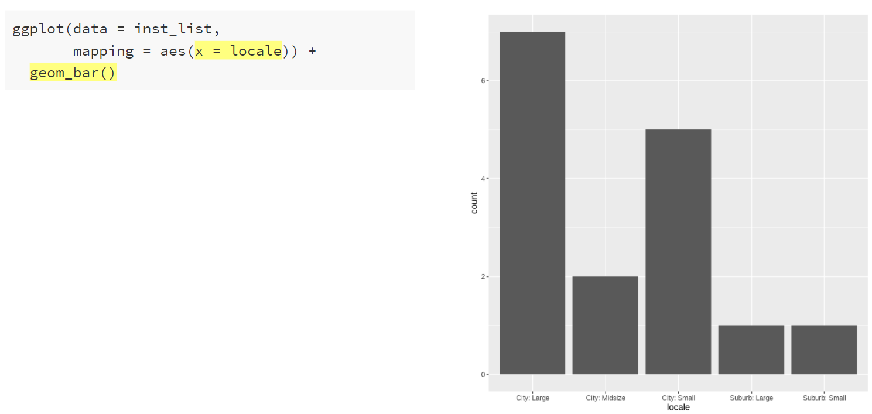
Plotting in R – Geometric Objects
Notes:
For a bar graph, geom_bar() will compute summary information for us, so we just need to provide the x-axis category and geom_bar() will compute the count. We can provide other functions instead of the count, and we can make bar graphs using a provided y variable, as we’ll see shortly.

Slide 54
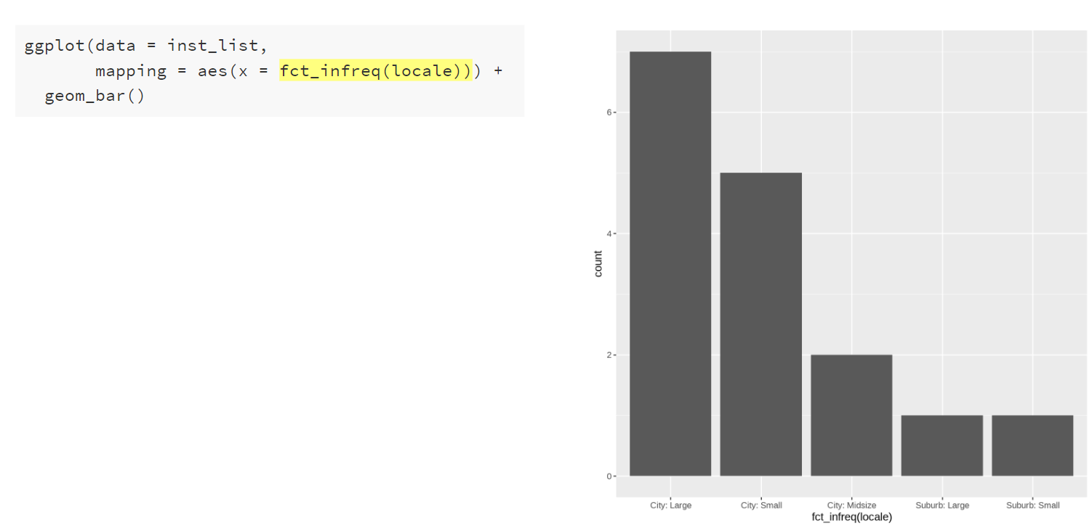
Plotting in R – Aesthetic Mapping
Notes:
We can reorder the bars from greatest to least frequency/count using a handy function fct_infreq(). This function is from the forcats package in tidyverse; fct_infreq() reorders the levels by their frequencies. There are a few ways that reordering the data on an axis or legend can be accomplished; this is just one way. But it usually occurs within the mapping argument.

Slide 55
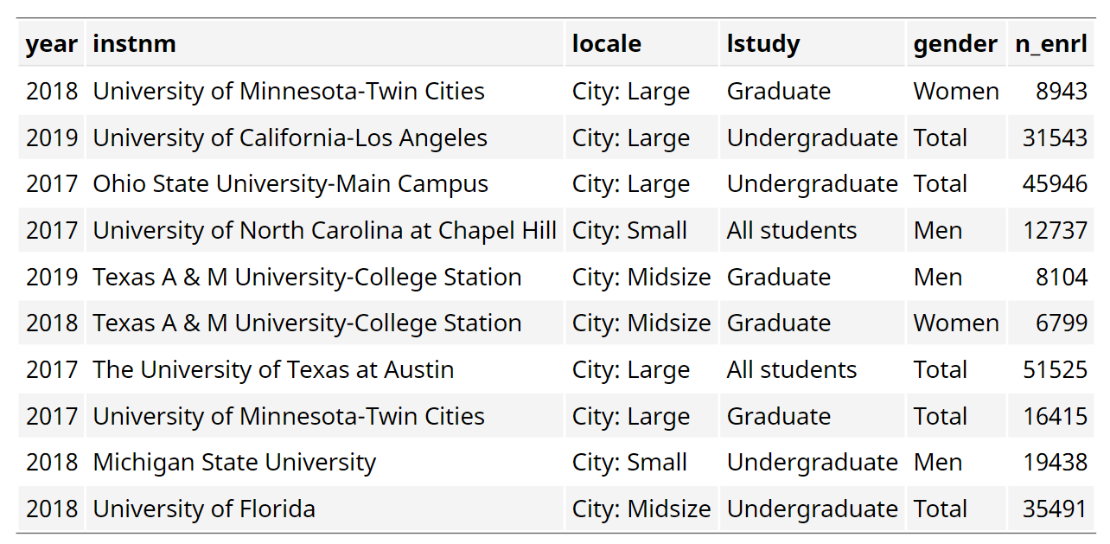
Plotting in R – Tidy Data (inst_enrlmnt_plot)
Notes:
What if we want to plot something other than counts in a bar graph?
This dataset is the enrollment by year for each institution, at the level of study, and by gender. We will be filtering to “All Students” and “Total” to make a plot of enrollment by locale/urban area.

Slide 56
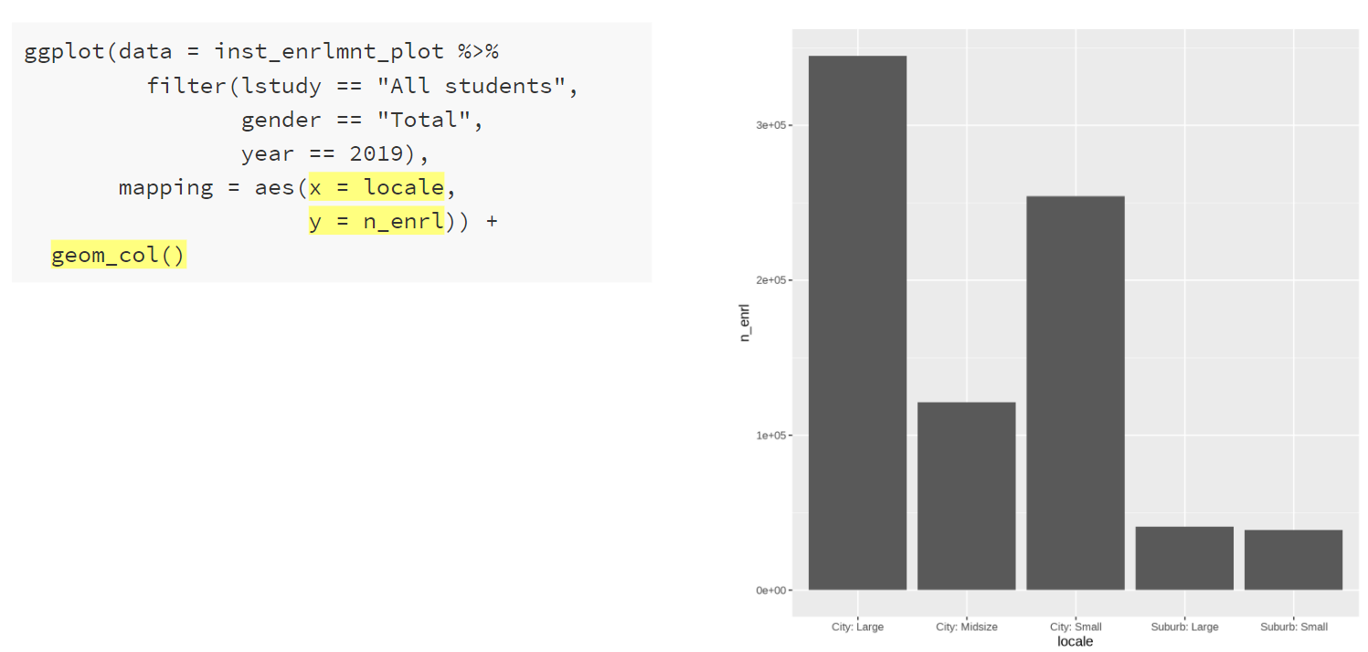
Plotting in R – Geometric Objects
Notes:
Here’s a different geom function – geom_col() this function plots the total of the numeric variable provided in the x or y mapping. In this case, we’ve got y = n_enrl so it’s plotting the total enrollment for each locale/urban area. Let’s see this in more detail.

Slide 57
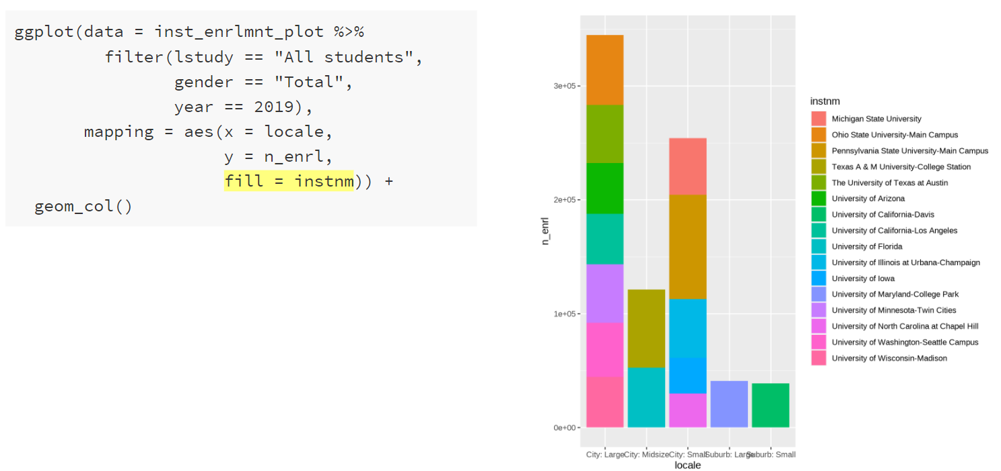
Plotting in R – Aesthetic Mapping
Notes:
By adding a fill argument to the aes() function in the mapping argument, we’ve added color to the bars. One color for each institution. Now we can see how the geom_col() function is putting each institution’s enrollment on top of each other to create this chart. Later on we’ll see how we could make side by side bars instead of stacked bars.

Slide 58
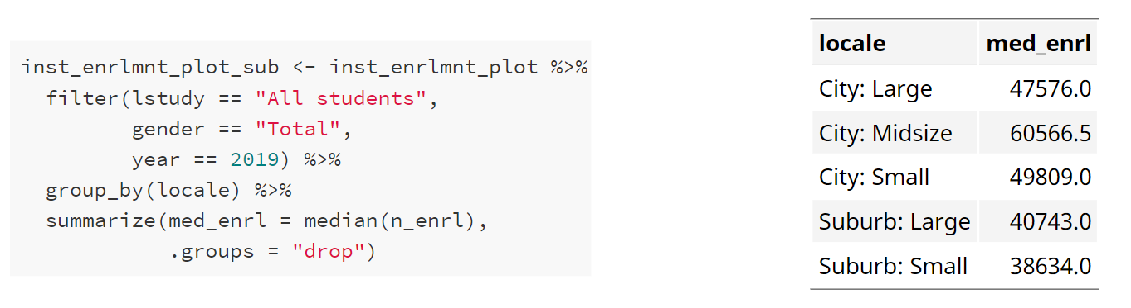
Plotting in R – Tidy Aggregated Data
Notes:
What if we want to plot the median enrollment by area instead of the total?
We can make an aggregated dataset and then plot it.

Slide 59
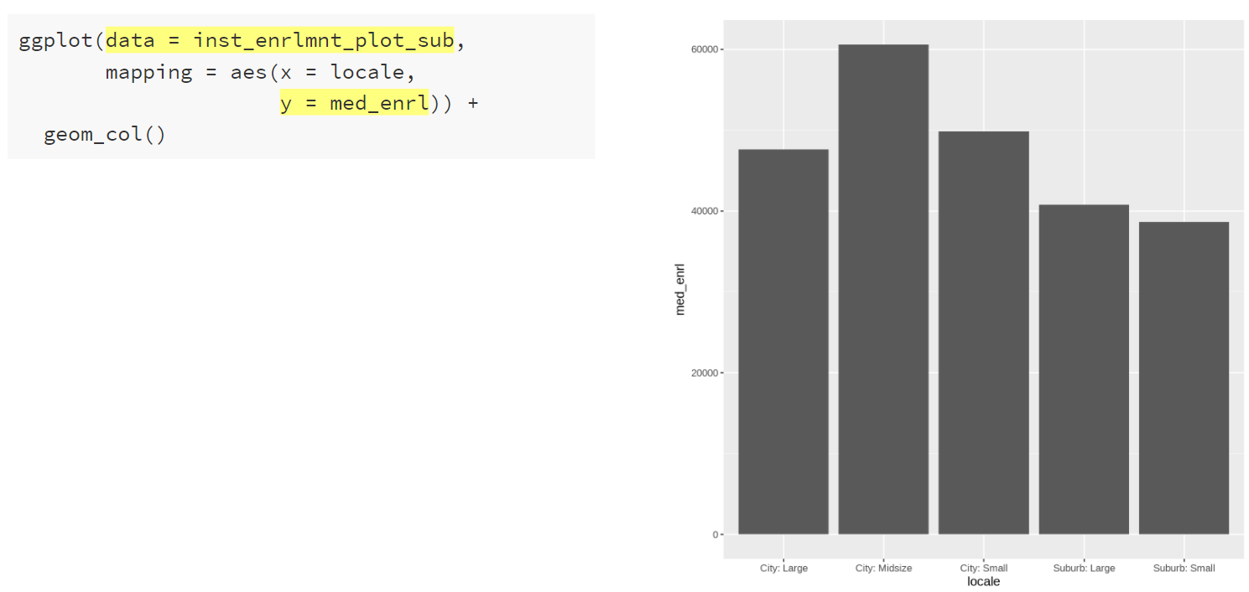
Plotting in R – Bar Graph of Aggregated Data
Notes:
With the aggregated data set, we can set the mapping to plot med_enrl on the y-axis.

Slide 60
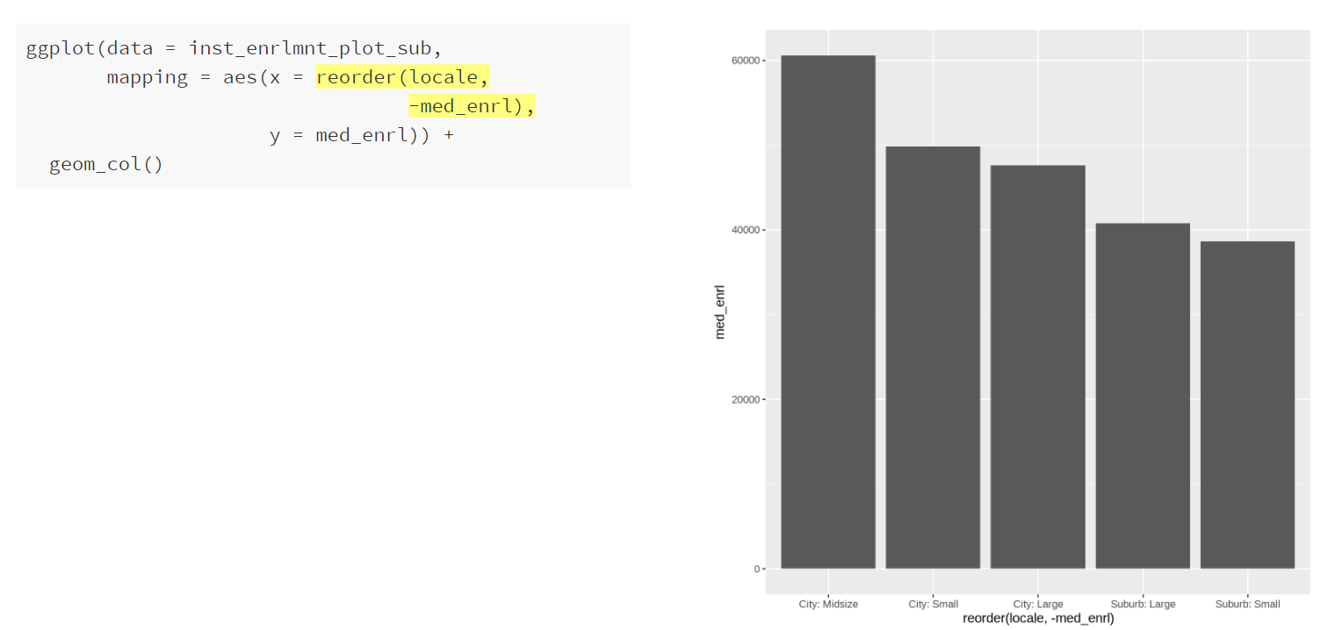
Plotting in R – Bar Graph of Aggregated Data
Notes:
Then we can reorder the x-axis values by the med_enrl. This is another method of sorting data within ggplot. In this case, we’re using the reorder() function. The first argument is the variable to reorder and the second argument is the variable to reorder the first variable by. We use a minus sign in front of med_enrl to sort in descending order.

Slide 61
Plotting in R – Tidy Data (inst_enrlmnt_plot)
Notes:
Going back to this data, what if we wanted to plot the enrollment by institution and locale/urban area? How could we make a plot with all of the institutions subset by urban area?
Faceting is how small multiples can be made in R/ggplot.

Slide 62
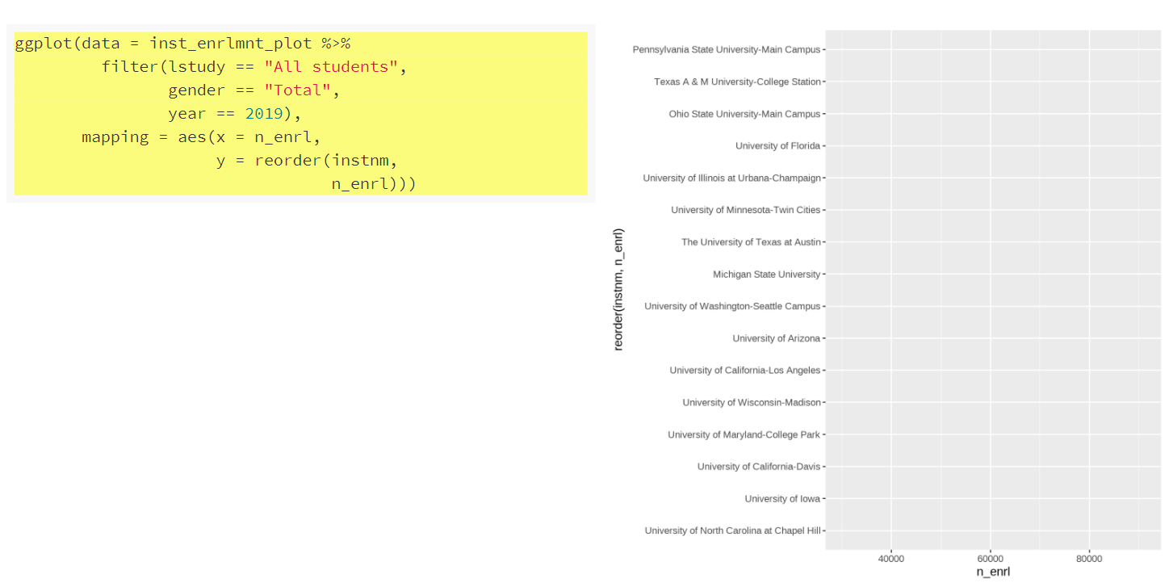
Plotting in R – Facets
Notes:
We start with the ggplot() function. Setting our data to our enrollment data set and filtering to All Students and Total gender and 2019. Then we add the mapping of enrollment to the x-axis and institution name, ordered by enrollment to the y-axis.

Slide 63
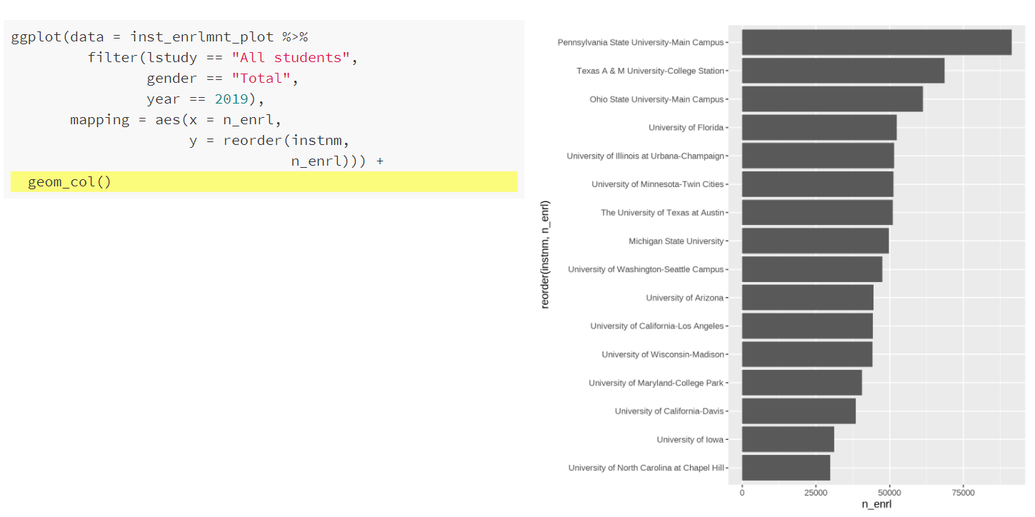
Plotting in R – Facets
Notes:
We add on geom_col() to make the bars.

Slide 64
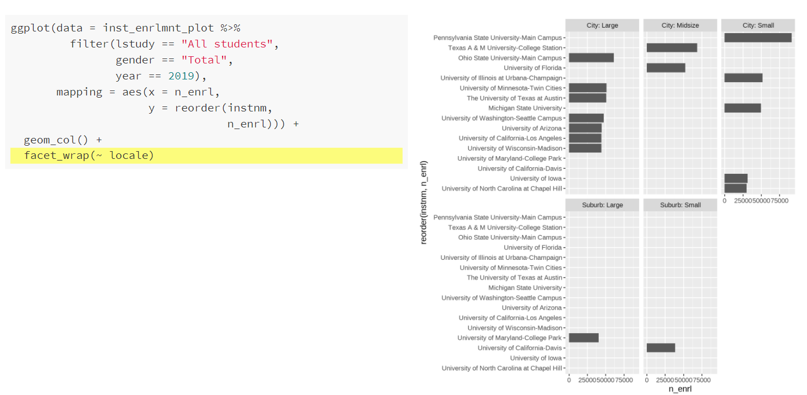
Plotting in R – Facets
Notes:
Then we use the facet_wrap() function to make small multiples for each locale/urban region. Essentially, we’re saying, make a new plot like this for every locale. But, we don’t really need every institution on each plot, because each institution is only in one locale. And maybe it would look better if all the small plots were in one column.

Slide 65
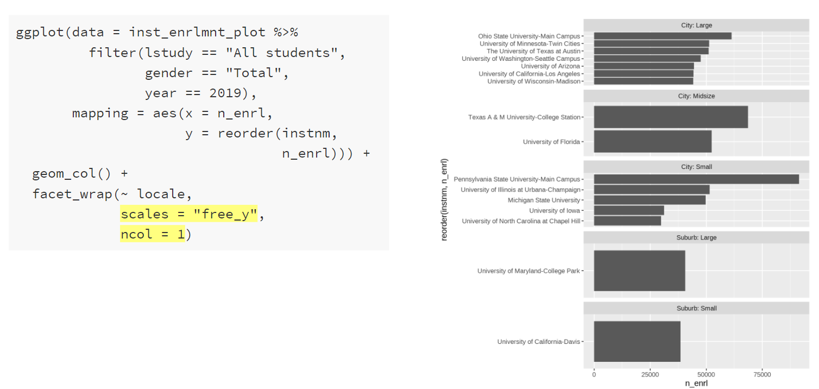
Plotting in R – Facets
Notes:
We do this by setting the scales argument to “free_y” within the facet_wrap() function, which means that each plot gets it’s own y-axis. We also set ncol to 1 within facet_wrap(), which puts all the plots in one column.

Slide 66
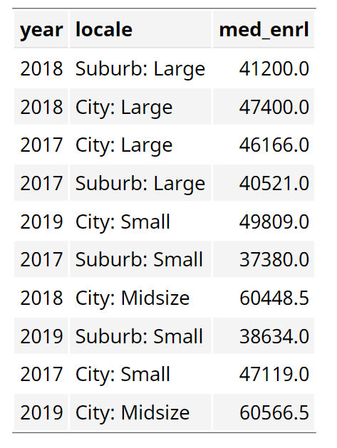
Plotting in R – Tidy Aggregate Data (inst_enrlmnt_plot_sub)
Notes:
Before we looked at median enrollment by locale/urban area in a single year - 2019. Now we’re going to look at median enrollment by locale/urban area over time.

Slide 67
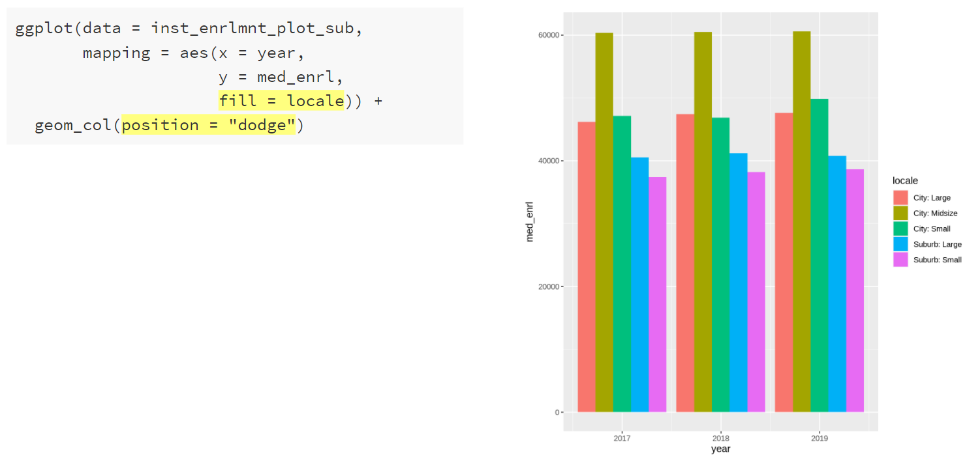
Plotting in R – Aesthetic Mapping & Geometric Objects
Notes:
Using fill in the aesthetics function, we can add color to the bars (as we saw earlier). Now we will also add position = “dodge” to the geom_col() function to put the bars next to each other in each year. When we add a variable to the fill mapping, you’ll notice that ggplot automatically gives us a legend.

Slide 68
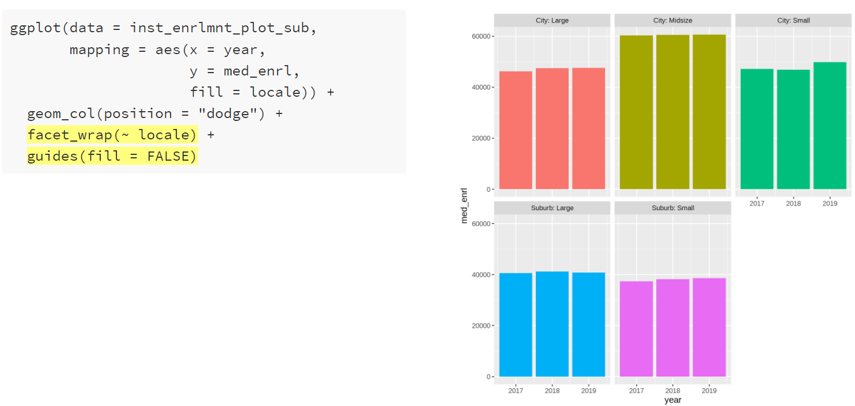
Plotting in R – Facets & Formatting
Notes:
We can use facet_wrap to make small multiples by locale/urban area and remove the legend using guides(fill = FALSE). Note that we don’t really need position = “dodge” here anymore since each faceted plot will only have three columns, one for each year.

Slide 69
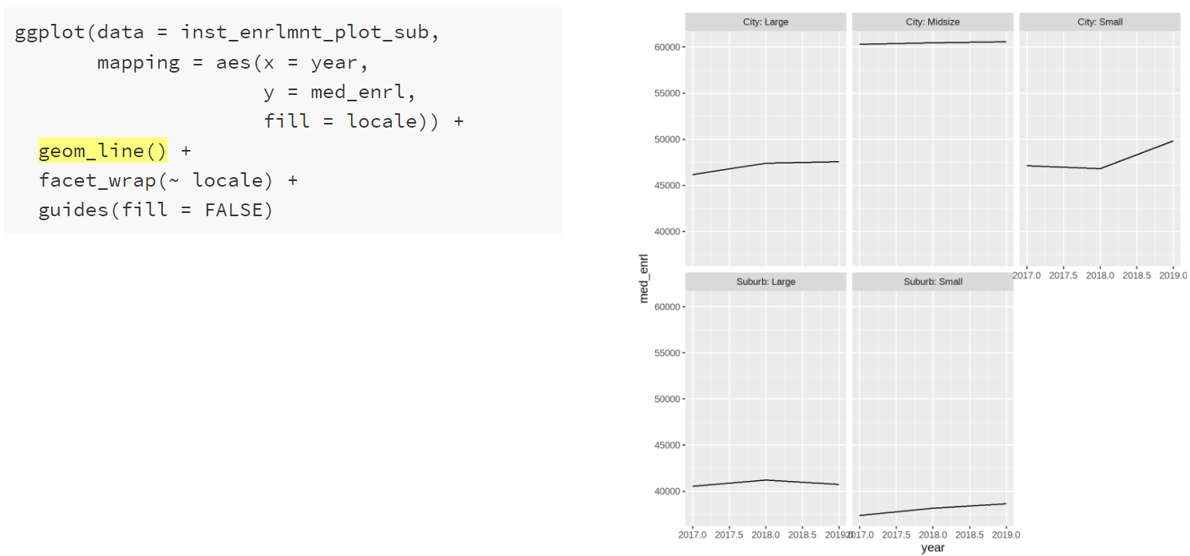
Plotting in R –Geometric Objects
Notes:
Trends over time look best with lines rather than bars, so we can replace the geom_col() with geom_line. But what happened to the color? We still have fill set.

Slide 70
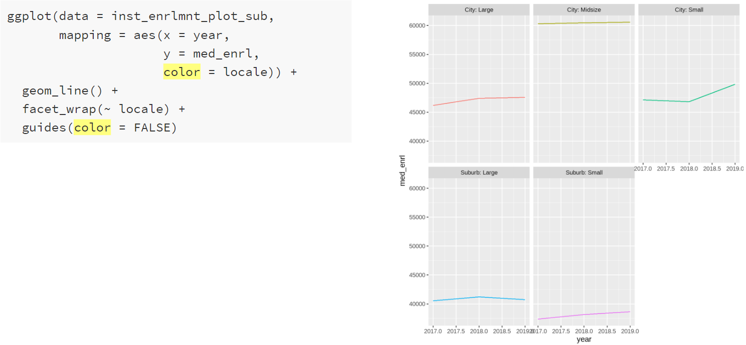
Plotting in R – Aesthetic Mapping
Notes:
For lines and points, we use the aesthetic mapping color while for bars, histograms, and boxplots, we use the aesthetic mapping fill.

Slide 71

Plotting in R – Tidy Data (inst_compl_plot)
Notes:
So far, we’ve gone over a few different plot types, how to add color, and faceting. But how do you edit the colors and theme of the plot to get something that looks really nice? We’ve seen some pretty strange and unhelpful axis labels? How do we fix that?
We’ll now discuss how to add labels and formatting. We’re going to use data on degree completions. This data provides the number of degrees awarded by year, institution, degree level, and gender.

Slide 72

Plotting in R – Initial Plot
Notes:
This is the initial plot. For the University of Arizona (filtered by unitid), this plot show the number of degrees awarded over the past three years by award level.
A few things to notice, the degree levels are not in a sensible order, the years have decimal points, the axis labels are not ideal (especially the y-axis), there’s no title, and it might be nice to have something other than the grey plot background and perhaps alternate colors for the degree levels.

Slide 73

Plotting in R – Reorder Degree Levels
Notes:
First we will reorder the degree levels. This is now the third way we’ve used to reorder values. In this instance, we are manually setting the factor levels for the award level variable to be the order we want. Notice the change to the legend title as well.

Slide 74

Plotting in R – Add Titles
Notes:
Second, we’ll add a plot title and change the x-axis title. Then we’ll remove the y-axis and legend titles.

Slide 75

Plotting in R – Move Legend
Notes:
Next, we will move the legend to the top of the plot

Slide 76

Plotting in R – Add Caption
Notes:
Adding a caption argument in the labs() function allows us to note where the data came from.

Slide 77

Plotting in R – Add Theme
Notes:
Then we’ll add a theme to change the background and appearance of the plot. There are several built in themes in ggplot2; there are also additional packages that have more themes like ggthemes and hrbrthemes. Here we’re using theme_minimal() from ggplot2. The background is now gone; the axis ticks now match the gridlines; the legends has a white background; and the gridline color is now grey.

Slide 78

Plotting in R – Adjust Scales
Notes:
We can easily add commas to the y-axis labels using the scale_y_continuous() function and the comma function from the scales package on the labels argument.

Slide 79

Plotting in R – Adjust Scales
Notes:
We can also remove the decimals from the x-axis and remove the half-year (2017.5, etc.) labels using scale_x_continuous() and the breaks argument, which allows us to manually set the x-axis breaks or x-axis ticks.

Slide 80

Plotting in R – Adjust Scales
Notes:
We can manually set the labels for the x-axis in scale_x_continuous(). Here we set it to a vector of labels we created.

Slide 81

Plotting in R – Geometric Objects
Notes:
It might be nice to have points for each year with lines connecting them. We can layer geoms to make this happen. Note the show.legend = FALSE in the geom_line() function. Without this, the legend would show a line and a point.

Slide 82

Plotting in R – Adjust Scales
Notes:
Scale functions are also available for the color (and fill). Here we use scale_color_brewer() to select a color palette from ColorBrewer.

Slide 83

Plotting in R – Adjust Scales
Notes:
Scale functions are also available for the color (and fill). Here we use scale_color_manual() to set our own colors using hex codes for University of Arizona brand colors. Note how the values in the scales_color_manual() correspond to the levels of the variable mapped to color.

Slide 84

Plotting in R – Saving
Notes:
To save, assign the plot to an object (line_plot) and then use the ggsave() function. Here you can set the output type (png, svg, jpg, pdf) and you can set the width and height to get the formatting and output to look right.

Slide 85

Plotting in R – Saving
Notes:
To save, assign the plot to an object (line_plot) and then use the ggsave() function. Here you can set the output type (png, svg, jpg, pdf) and you can set the width and height to get the formatting and output to look right.

Slide 86
What’s Possible with ggplot2?

Slide 87
Artwork by @allison_horst
Notes:
ggplot2 can also be used to create well designed and engage data visualizations and infographics. It’s flexibility allows for almost endless customization.

Slide 88
Artwork by @allison_horst
Notes:
ggplot2 can be used to complete visual data exploration. Once you get the hang of it, it’s very easy to quickly generate rough plots to explore your data.

Slide 89
Where to go next
Experiment with the provided code and data sources. There are many other plots that could be made using this data.
Some Resources:
ggplot2: Elegant Graphics for Data Analysis by Hadley Wickham
Data Visualization Chapter in R for Data Science by Hadley Wickham & Garrett Grolemund
ggplot2 Reference Guide
Notes:
The provided code includes tidy data for completions, enrollments, and admissions for the 16 schools selected. It could also be adapted to include different institutions but be aware that I manually set some of the descriptive values, and they may not match a different list of institutions. That being said, the dictionaries are included in the zip file of documents for this webinar, so you could adapt the code as needed using the dictionaries. Play around with the provided code and see what happens if you change the arguments. Try to create similar plots with different datasets, for example, make a bar plot of the degrees awarded. How could you make a lollipop chart or a dot plot of degrees awarded rather than a bar plot? Ggplot2 can be used to make many, many different kinds of plots from histograms and box plots to maps and Sankey diagrams.

Slide 90
What did we learn today?
How to make a bar graph in R
How to make add titles and labels to a graph in R
How to change the formatting of a graph in R
How to save a graph in R
Where to find more information on ggplot2

Slide 91
Questions

Slide 92
References
Bufe, A. (2019, November 26). Gestalt principles: The complete overview. Retrieved March 08, 2021, from https://uxcam.com/blog/gestalt-principles/
Cairo, A. (2016). The truthful art: Data, charts, and maps for communication. New Riders
Few, S. (2004). Tapping the Power of Visual Perception. Retrieved March 7, 2021, from https://www.perceptualedge.com/articles/ie/visual_perception.pdf
Healy, K. (2019). Data visualization: A practical introduction. Princeton, NJ: Princeton university press.
Wickham, H. (2010). A layered grammar of graphics. Journal of Computational and Graphical Statistics, 19(1), 3-28. Retrieved March 7, 2021, from http://vita.had.co.nz/papers/layered-grammar.pdf

